Slide 1

London Borough Of Hillingdon
Performance Report 2025/26

Slide 2
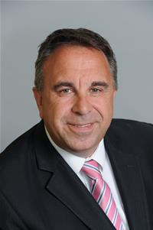

​For councils, performance management uses data to drive evidence-based decision making, challenging current ways of working and service delivery models. It helps local government take responsibility for its performance and allows our residents to hold us to account, ensuring we are meeting local needs and spending their money wisely.
Performance management involves setting shared goals and measuring progress towards them. It ensures governance arrangements are in place to achieve an authority's objectives. In Hillingdon, performance is aligned with the Council Strategy, providing performance reports to services, senior management teams, the Corporate Management Team, and the Leader and Cabinet.
This annual report uses key performance indicators and monitoring data to show the performance of key services for the financial year 2025/26 (it should be noted that 2024/25 is the latest data for some metrics). Where possible, we have benchmarked these against comparable authorities and have used the latest published data.
​​
Leader of the Council: Cllr Steve Tuckwell

Slide 3



Our commitments to residents
Cabinet Member: Cllr Nick Denys
Portfolio: Planning, Housing and Property
Thriving, healthy households
A thriving economy
Safe and strong communities

Slide 4
Corporate Director: Dan Kennedy, Residents Services
Along with most of London, demand from homeless households in Hillingdon is high, in part driven by private sector landlords evicting tenants combined with a shortage of suitable and affordable housing supply, which has in turn increased the use of temporary accommodation. The Housing Service is facing both a rising inflow and a slower outflow from temporary accommodation. We have seen rising homelessness presentations, with new approaches to the Council from homeless households consistently above 600 each month. Expenditure on accommodation increased in 2024/25, with rising demand and higher private rental costs pushing up spending, coupled with an increase in higher-unit cost placements. During 2025/26 a strategy to reduce the use of temporary accommodation and associated expenditure by preventing homelessness, securing more private and social rented accommodation and introducing price controls was actively delivered. Proactive market management has achieved results; after a nightly cost cap was introduced at the start of 2025/26, tenancies above the price cap reduced significantly during the year. Hillingdon has a lower than average number of children placed in temporary accommodation with their family – our plans to reduce the use of temporary accommodation will secure more settled accommodation for more families with children.
The Council Housing Landlord Repairs Service continues to show clear improvement momentum — both completion levels and on-time delivery have continued to improve, with sustained achievement since September 2024. Repair demand is high and steady — 3,000 repair requests per month are logged, with emergency volumes stable and routine repairs fluctuating modestly. Completion performance is improving — overall repair completion rates are steadily rising, indicating stronger operational delivery despite sustained demand. Responsive repairs completed per 1,000 properties remains below the target of 295. However, the on-time completion target is consistently above 89%. Repairs performance has shifted from pressure management to more dependable delivery.
Turning to the Planning Service, the volume of planning applications has remained consistently strong, with approximately 3,250 applications received during 2025/26. The Development Management Service has maintained a high level of performance for the timely determination of applications. While the proportion of appeals allowed at 42% is currently above the London average and represents an increase on the previous year, this is being actively addressed. Ongoing work to systematically review appeal outcomes is helping to refine decision-making processes, strengthen policy application, and drive continuous improvement in performance. The Building Control Service has taken a proactive approach to safeguarding residents by increasing enforcement activity, ensuring that poor construction practices are identified and addressed more effectively, and contributing to higher standards across developments.
Significant progress has been made in advancing the council’s place-shaping priorities. This includes the adoption of the Uxbridge Vision, the development of a regeneration framework for Hayes, the preparation of the council’s first Growth Plan, and continued progress on the Local Plan review. The planning authority is also proactively preparing to respond to the government’s proposals for the expansion of Heathrow Airport, including a third runway. These proposals present far-reaching place-shaping implications extending well beyond the airport boundary. In parallel, changes to national planning policy, particularly in relation to the green belt, are being carefully considered. In light of these evolving factors, the decision has been taken to allow more time to consider the current the stage of the Local Plan. This will ensure that a robust, comprehensive and coordinated response can be developed, positioning the borough to effectively manage future growth and respond to strategic challenges and opportunities.

Slide 5
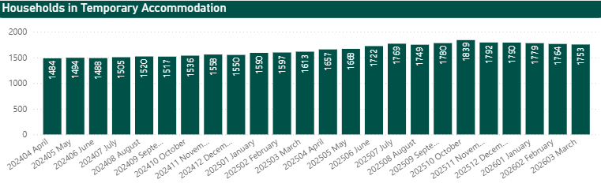
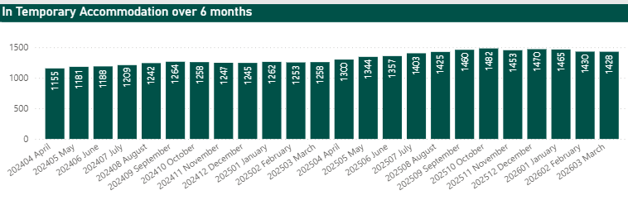
Housing Needs and Homelessness
In line with the rest of London, Hillingdon is experiencing increased demand from homeless families for assistance, given the shortage of affordable suitable accommodation. High demand is coming from private tenants experiencing evictions by their landlord in a market where there is strong demand for private rented homes, including from those living in inner London.
When a household approaches us at risk of homelessness, we have a duty to help them. If attempts to prevent homelessness are unsuccessful, we place the household into temporary accommodation, if they are eligible.
The number of households in temporary accommodation has continued to rise steadily since mid-2023, peaking at 1,839 in October 2025. 1,753 households were living in temporary accommodation in March 2026.
Alongside this, the number of households staying in temporary accommodation for over six months (lower slide) has increased, reflecting the challenges in securing suitable affordable alternative housing.
The continued rise in both overall usage and duration reflects sustained pressure on housing supply and limited exit pathways from temporary accommodation.

Slide 6
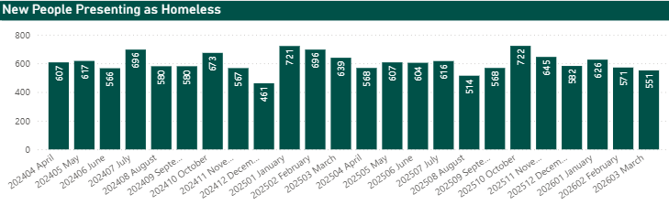
Housing Needs and Homelessness
This is the number of new residents who are asking for support that are at risk of being homeless leading to increases in temporary accommodation usage and spend.
The number of new homelessness presentations each month has shown a significant increase during the last three years. In April 2023, there were 297 new cases, rising sharply to a peak of 722 in October 2025, indicating a year-on-year upward trend. This suggests increasing pressure on housing and support services, particularly during the winter months, where figures were consistently above 600.

Slide 7
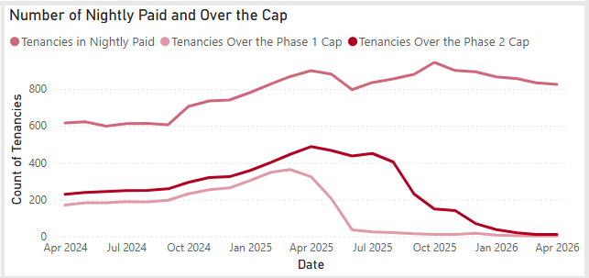
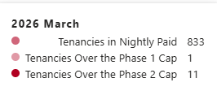
Housing Needs and Homelessness
The cost of paid accommodation and the number of high-cost tenancies continued to increase in 2024/25 - largely due to increasing demand, the rising cost of renting accommodation from private landlords, the cost of which was offset by the council using more of its own properties for temporary accommodation.
With the introduction of a new policy to capping nightly costs (introduced at the beginning of 2025/26), high-cost tenancies over the price cap have reduced considerably throughout the financial year.

Slide 8
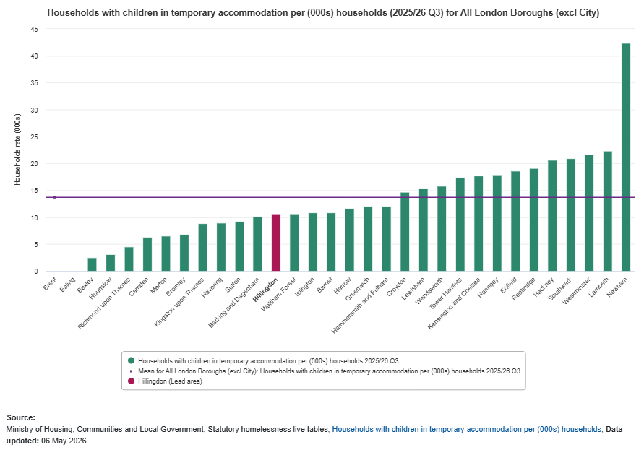
Housing Needs and Homelessness
The London comparison chart shows a very wide variation for the number of children living in temporary accommodation across boroughs, with a small number of boroughs much higher than the rest; the horizontal line is the London average (not a target).
Hillingdon has a lower than average number of children placed in temporary accommodation with their family – our plans to reduce the use of temporary accommodation will secure more settled accommodation for more families with children.

Slide 9
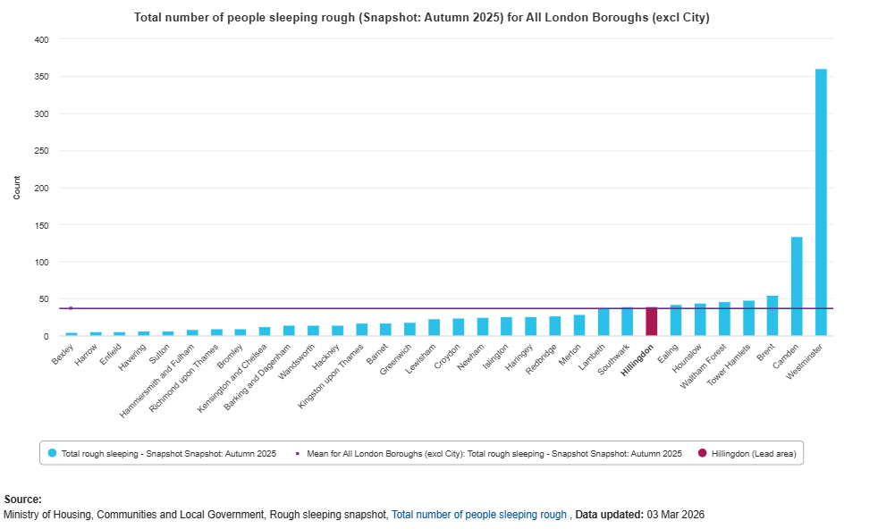
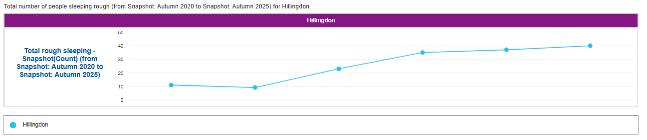
Housing Needs and Homelessness
People sleeping rough are defined as those sleeping or about to bed down in open air locations and other places including tents and make-shift shelters. The snapshot does not include people in hostels or shelters, sofa surfers or those in recreational or organised protest, squatter or traveller campsites. The snapshot records only those people seen, or thought to be, sleeping rough on a single night. The snapshot does not include everyone in an area with a history of sleeping rough, or everyone sleeping rough in areas across the October to November period.
The count includes Heathrow Airport which does attract additional rough sleepers to Hillingdon. The Council works closely with partner organisations in Hillingdon and London including Heathrow Airport Limited to provide supportive pathways to end rough sleeping.
The annual snapshot takes place in the autumn (between 1/10 and 30/11), rather than summer where numbers are likely to be higher due to warmer temperatures, or winter, where numbers may be lower as there are more temporary night shelters set up to ensure people do not sleep on the streets in very cold weather.
Local authorities across England take an annual autumn snapshot of rough sleeping using either a count-based estimate of visible rough sleeping, an evidence-based estimate meeting with local partners, or an evidence-based estimate meeting including a spotlight count in specific areas.
Hillingdon’s value is 40, just above the London average of 37.

Slide 10
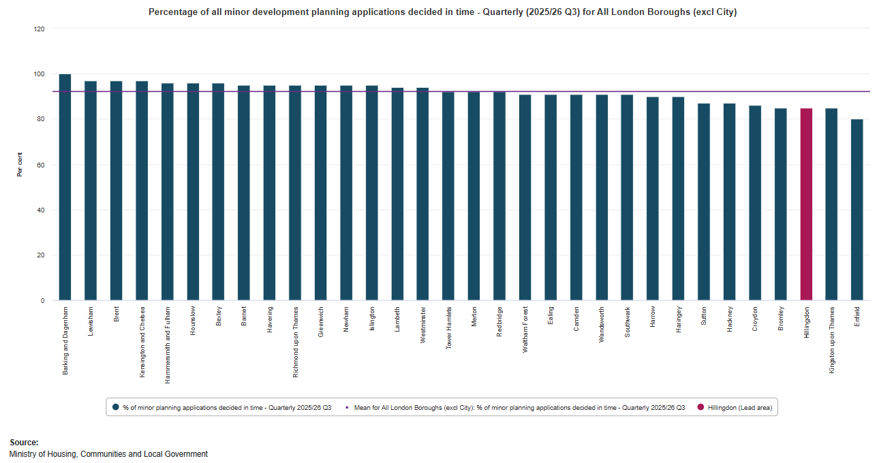
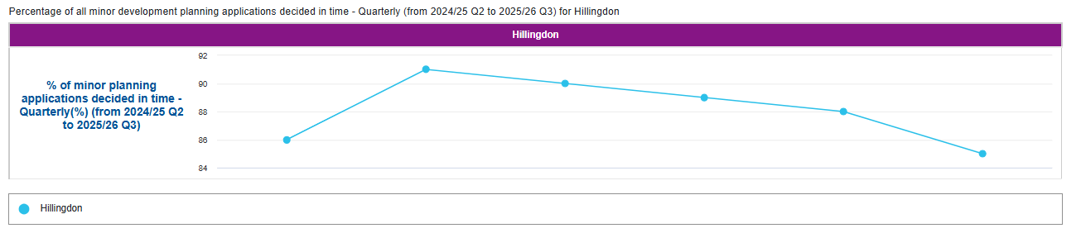
Building Control and Planning
This is the percentage of all minor development planning applications (PAs) whether or not they have a Planning Performance Agreement (PPAs), Extension of Time (EoT) and/or Environmental Impact Assessment (EIA), determined in a timely manner.
A timely manner is statutorily defined as within eight weeks or unless an application is subject to Environmental Impact Assessment, in which case a 16- week period applies, for all minor applications.
Minor includes:
dwellings, general industry / storage and warehousing, offices, light industry, retail and services, traveller caravan pitches and other developments.

Slide 11
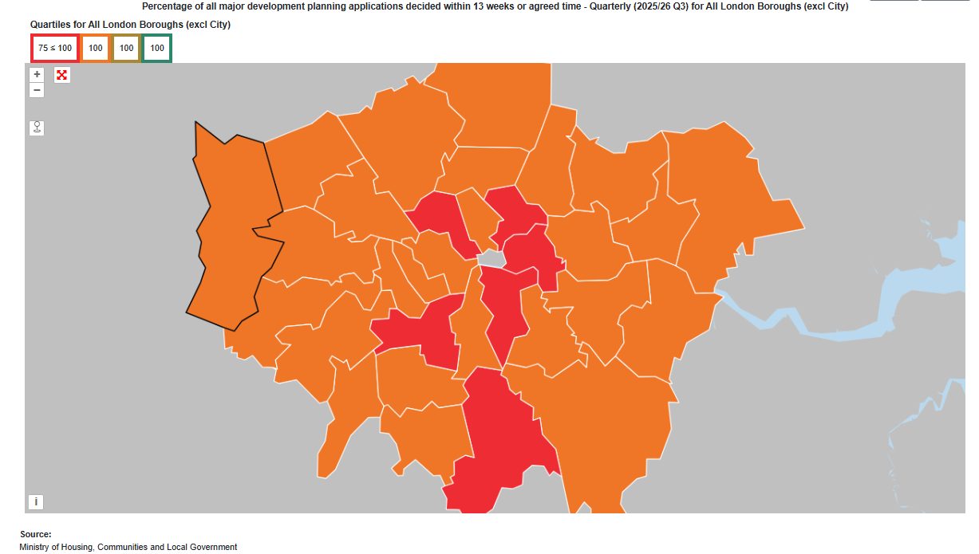
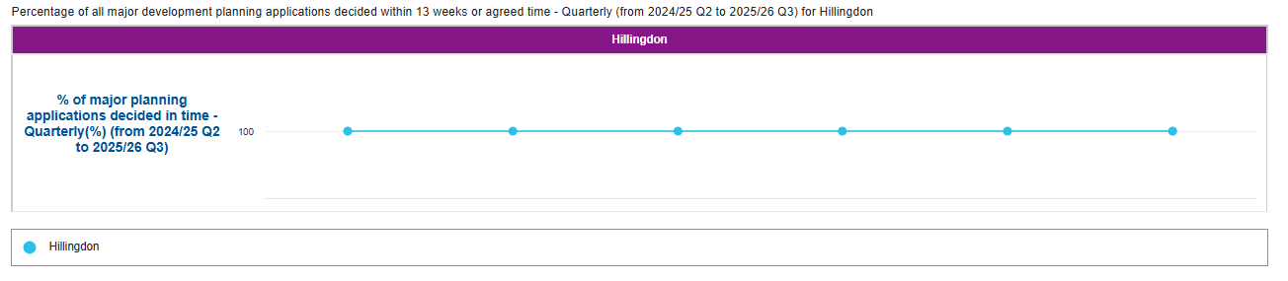
Building Control and Planning
This is the percentage of all major development planning applications (PAs) whether or not they have a Planning Performance Agreement (PPAs), Extension of Time (EoT) and/or Environmental Impact Assessment (EIA), determined in a timely manner, each financial year.
A timely manner is statutorily defined as within 13 weeks or unless an application is subject to Environmental Impact Assessment, in which case a 16-week period applies, for all major applications.
Major includes the same categories as minor but also public service infrastructure developments.

Slide 12
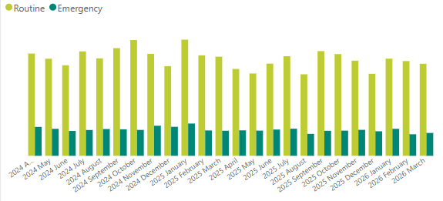
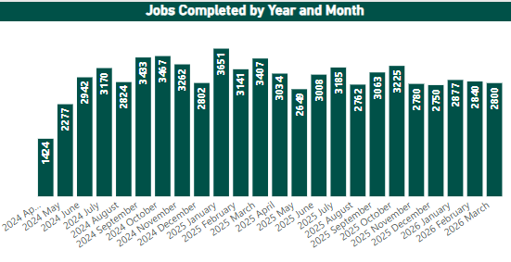
Operational Assets – Housing Repairs
The top graph looks at the number of jobs that have been logged that are either classed as emergency or routine.
Emergency jobs require either next day or out of hours attendance.
Routine jobs are up to 90 working days depending on the severity.
The bottom graph looks at overall jobs completed.
Each month, typically more than 3,000 repair requests are logged. Emergency job volumes have remained stable, while routine repairs have fluctuated slightly. Despite this, overall repair completion rates have steadily improved, meaning more issues are being resolved on time. This improvement helps ensure that homes remain safe, functional, and comfortable.
A more reliable Repairs Service also means residents experience fewer delays, with reduced need for repeated follow-ups.
The significant capital investment programme being delivered to improve homes for Hillingdon tenants will over time reduce the number of repairs required each month. This is already showing success, for example with the reduction in jobs for boiler repairs following the programme to replace boilers in domestic properties.

Slide 13
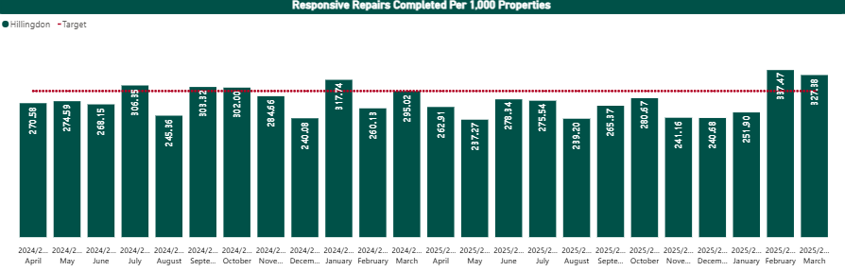
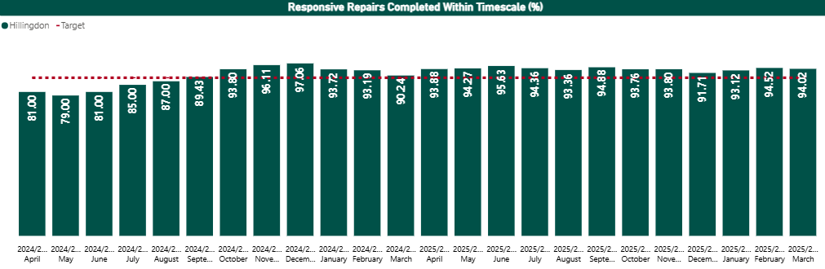
Operational Assets – Repairs
The top graph shows the number of responsive repairs completed for every 1,000 properties. This is used to measure the average core demand (target line) placed on the sector. Based on this, the sector's average is 295.
The bottom graph also looks at responsive repairs completed on time but as a percentage and the target for this is 89%.
Since September 2024, Hillingdon has consistently achieved the target of responsive repairs completed within the required timescales each month which means most residents can now expect a more dependable and timely repairs service.

Slide 14



Our commitments to residents
Cabinet Member: Cllr Wayne Bridges
Portfolio: Residents Services
A digital-enabled, modern, well-run council
Safe and strong communities

Slide 15
yr
Corporate Director: Dan Kennedy, Residents Services
Road condition performance
The condition of roads in Hillingdon is better than average. Classified roads are performing better than the wider benchmark — for A roads and motorways, Hillingdon is shown at 4% requiring maintenance versus a London average of 8%. B and C classified roads also compare well — Hillingdon records 2% requiring maintenance against a London average of 10%. Unclassified roads remain relatively strong — 5% versus a London average of 12%.
Department for Transport (DfT) Road Maintenance Ratings – Hillingdon is one of only two London boroughs ranked green on the DfT ratings map (released January 2026) demonstrating how effective Hillingdon is at tackling potholes and resurfacing roads.
Electric vehicle charging infrastructure
EV infrastructure has a strong and credible expansion plan in Hillingdon — current provision is low relative to London, but the funding and installation pipeline imply a meaningful future uplift.
Public charging availability in Hillingdon is behind London overall — Hillingdon is shown at 75.3 chargers per 100,000 population in Q4 2025, versus a London mean of 338.6.
Strategic investment is underway — a £7.5 million funding has been awarded through the Local Electric Vehicle Infrastructure programme. The borough is set to receive 1,673 new charging points, as part of a major expansion programme rather than incremental change.

Slide 16
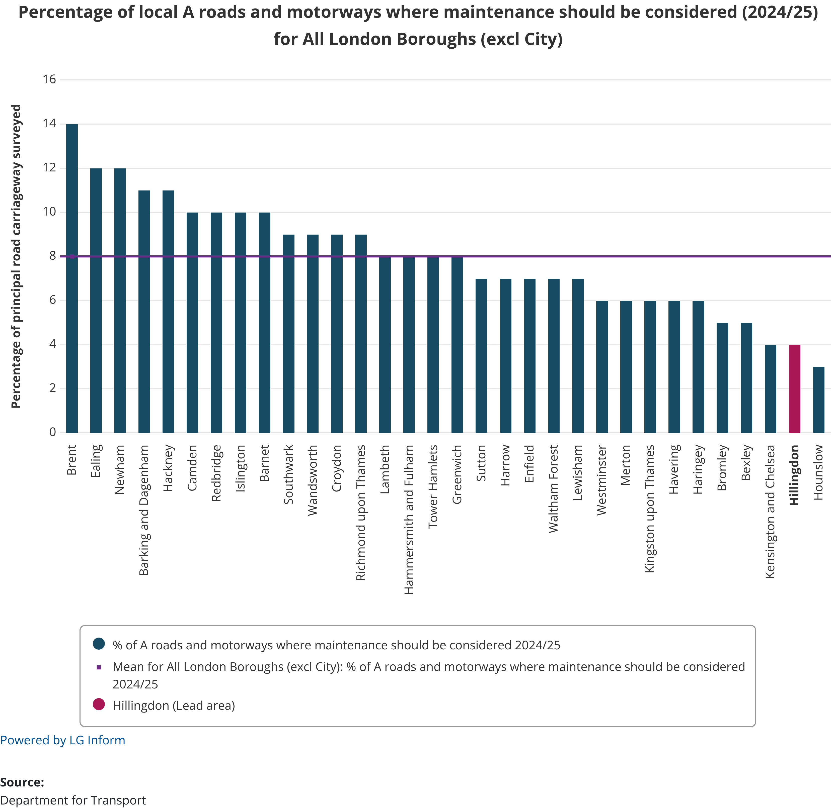
Highways – Classified Roads
This is the percentage of the local authority’s A roads and motorways (owned principal roads) where maintenance should be considered. This represents the percentage of road that is in the worst condition measured in 10 metre sections.
In 2024/25, the percentage of Hillingdon’s A roads and motorways where maintenance should be considered was 4%, which is below the London average (8%).

Slide 17
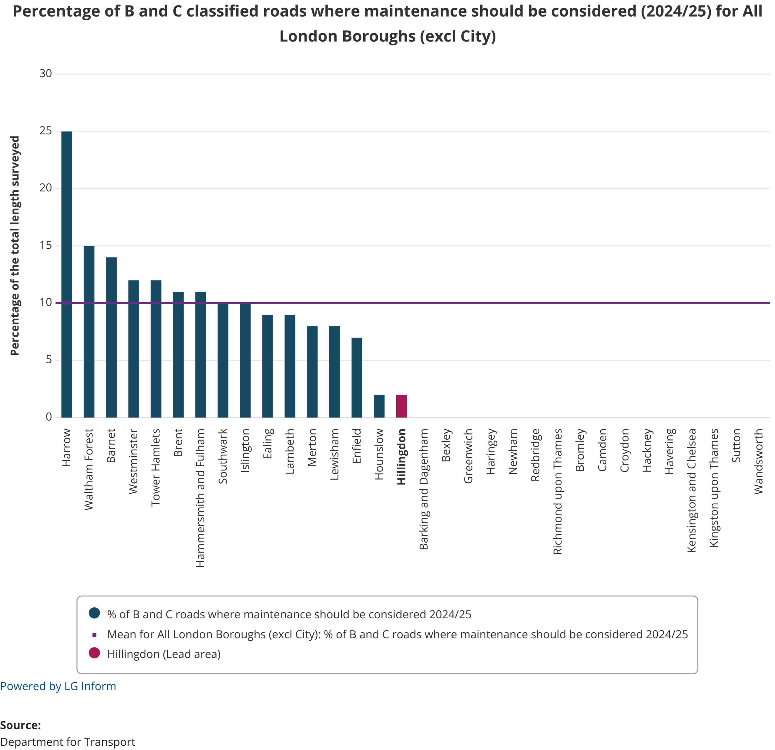
Highways – Classified Roads
This is the percentage of the local authority’s B and C roads (non-principal roads) where maintenance should be considered. This represents the percentage of road that is in the worst condition measured in 10 metre sections.
In 2024/25, the percentage of Hillingdon’s B and C roads where maintenance should be considered was 2%, which is below the London average (10%).
As the graph demonstrates, some authorities have not submitted data to the Department for Transport.

Slide 18
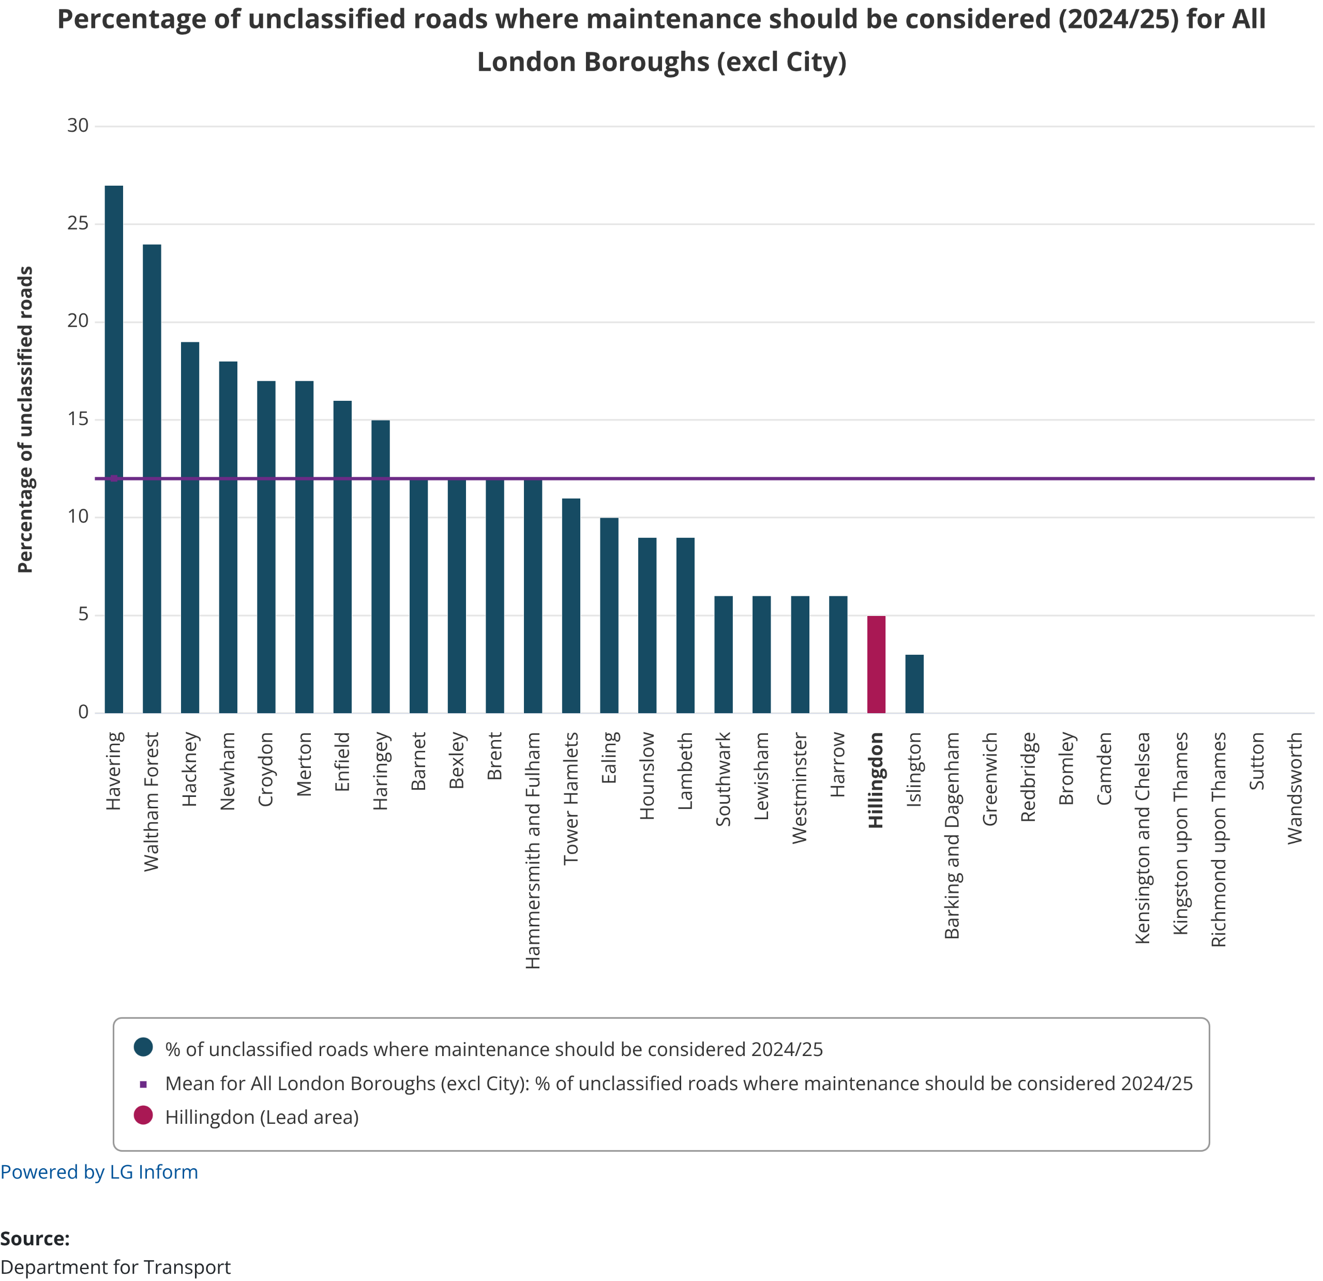
Highways - Unclassified Roads
This is the percentage of the local authority's unclassified roads (U roads) where maintenance should be considered. There is no mandated method for collection of U road condition, hence a variety of road condition monitoring techniques are used by local authorities.
In 2024/25, the percentage of Hillingdon’s unclassified roads where maintenance should be considered is 5%, which is below the London average (12%).
As the graph demonstrates, some authorities have not submitted data to the Department for Transport.

Slide 19
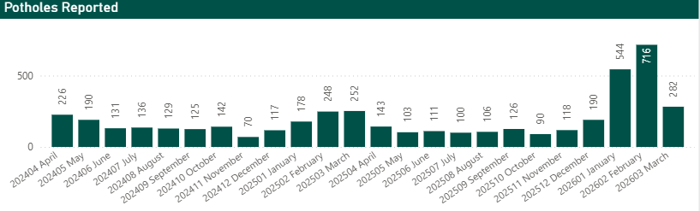
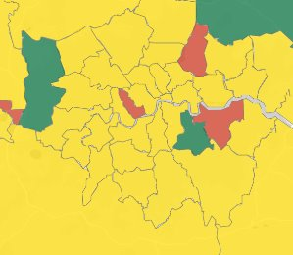
Highways - Potholes
This chart shows the number of potholes reported each month during the past two financial years. Potholes are a common concern for many residents as they affect road safety and can damage vehicles.
Looking at the data, you can see that the number of reported potholes can change a lot from month to month, often spiking in winter and early spring, when cold and wet weather causes the most damage to road surfaces. Compared to last year, this year has seen fewer reports in several months, especially in April and October, which shows improvement. The very wet period from January 2026 to March 2026 contributed to a spike in pot holes being reported.
By tracking these numbers, the council can better understand when and where road repairs are needed most and focus resources to keep roads safer and smoother for everyone in Hillingdon.
Department for Transport Road Maintenance Map
In January 2026, Hillingdon was one of only two London boroughs ranked green on the Department for Transport Road Maintenance Ratings map, showing how effective Hillingdon is at tackling potholes, resurfacing roads and restoring pride to a local area.​​

Slide 20
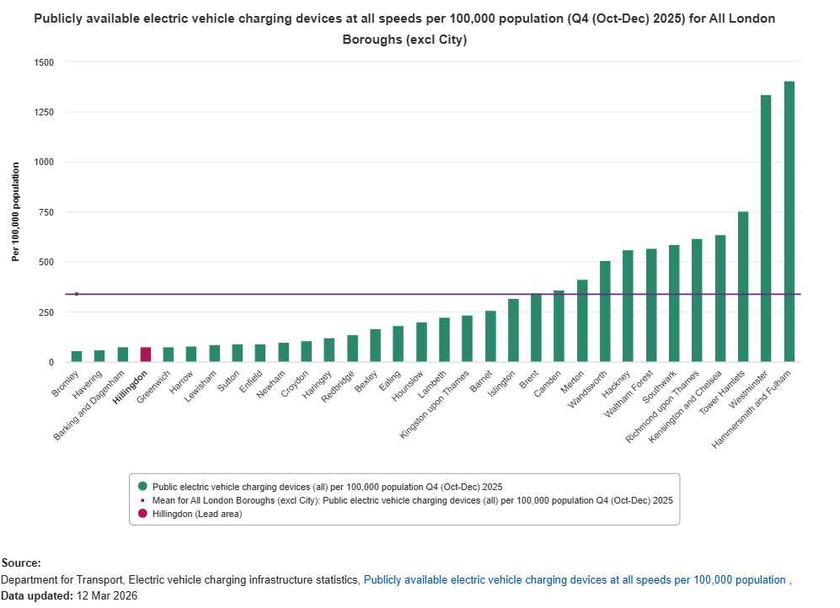
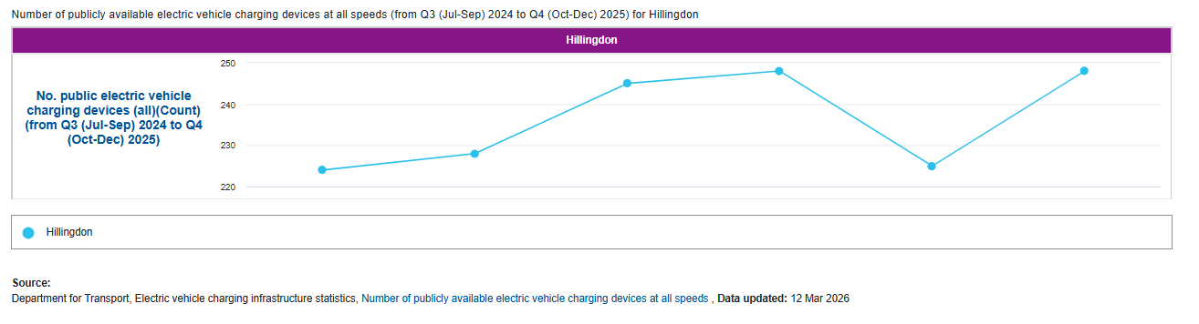
Highways – Electric vehicle (EV) charging
Public EV charging devices per 100,000 population
In Q4 (Oct-Dec) 2025, the number of publicly available electric vehicle charging devices (all speeds) per 100,000 population in Hillingdon was 75.3, which is below the London mean of 338.6 (based on charging devices at all speeds).
The council has joined forces with Brent, Ealing, Hammersmith & Fulham, Haringey and Harrow to secure £7.5 million from the government's Local Electric Vehicle Infrastructure (LEVI) fund.
The partnership is in the process of procuring a supplier to install and manage the new EV charge points across all five boroughs, with 1,673 new EV charging points set to be installed across Hillingdon.

Slide 21

Cabinet Member: Cllr Susan O'Brien
Portfolio: Children, Families, Health and Care
Thriving, healthy households
Our commitments to residents

Slide 22
Corporate Director: Julie Kelly, Children’s Services
Referrals into children’s social care are a key indicator of safeguarding demand, reflecting the volume of concerns reaching the threshold for statutory intervention and providing an important measure of both system pressure and the effectiveness of prevention and early help.
The number of children subject to Child Protection Plans has reduced over the year, which may indicate early impact from the revised social care delivery model. The number of Cared for Children has also fallen. However, this trend should be interpreted with caution, as 26% of the Cared for Children cohort are unaccompanied asylum-seeking children, where demand is externally driven and cannot be mitigated through prevention or early intervention.
Placement costs remain a major budget pressure. Although the number of external residential placements has reduced, the cost of those placements has continued to rise at rates significantly above inflation, reflecting sustained market instability and increasing complexity of need. Hillingdon also continues to carry a disproportionate level of responsibility for unaccompanied asylum-seeking children. Year-end figures alone do not fully capture this pressure, as once the borough reaches the 0.1% threshold, young people transfer to other authorities through the National Transfer Scheme. This sustained flow has a longer-term consequence for care leaver services, as the borough supports a disproportionately large care leaver cohort linked to previous asylum demand and to earlier years when the transfer scheme operated less effectively.
Hillingdon recorded 34 first-time entrants to the youth justice system in 2024, below the London average of 42, indicating comparatively stronger performance in preventing initial entry into the system. In the 12 months to Q1 2024, 28.8% of young people who had offended went on to reoffend, broadly in line with the London average of 28.9%. This suggests that while first-time entry is relatively well controlled, reducing reoffending remains a persistent challenge. The strategic response therefore rightly emphasises multi-agency intervention, recognising the links between offending, trauma, deprivation, discrimination, and unmet health needs.
Demand for SEND assessments continues to rise, both locally and nationally. This appears to reflect not only increasing levels of need, but also system uncertainty following delays to recent SEND reform announcements, which have contributed to anxiety among families and professionals. The resulting growth in demand is placing additional pressure on the DSG High Needs Block and has implications for the robustness of financial forecasting.
Funded early education uptake is a clear area of relative strength. In 2025, 87.3% of 3- and 4-year-olds in Hillingdon accessed funded early education, above the London average of 85.4%, suggesting strong engagement with universal early years provision.
Post-16 engagement presents a more mixed picture. In 2025, 2.5% of 16–17-year-olds were not in education, employment or training, slightly above the London average of 2.0%. However, this should be understood in the context of Hillingdon’s comparatively low rate of unknown destinations. This suggests that the higher NEET figure is more likely to reflect stronger tracking and identification than materially weaker participation.

Slide 23
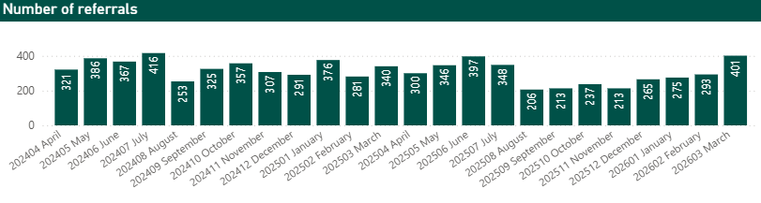
Children, Families, Health and Care – Social Care Demand - Referrals
A referral to children’s social services happens when someone is concerned that a child may be at risk of harm. This prompts the local authority to assess whether the child or family needs support or protection. All referrals require statutory intervention.
The graph shows the number of referrals received each month during the past two financial years. This helps us understand demand for services, spot emerging concerns, and evaluate the impact of early help and prevention work.
Referrals can come from many sources, including residents, schools, health professionals, or the police.

Slide 24
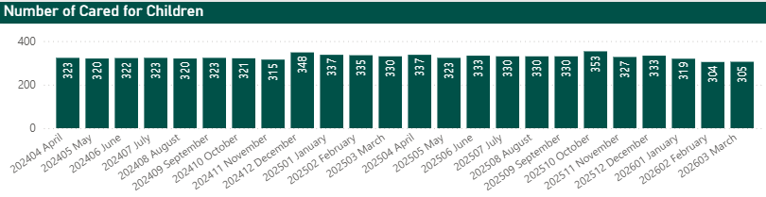
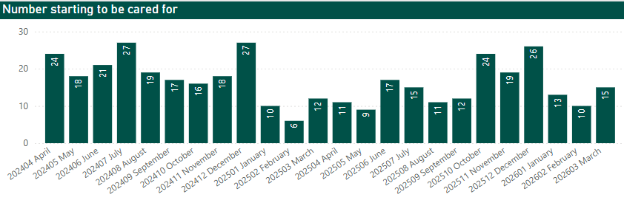
Children, Families, Health and Care – Looked After Children (Our Cared for Children)
Our children are those cared for by the local authority. This includes children seeking asylum who have no parent or guardian in the UK. The council and elected members hold parental responsibility and corporate parenting duties for most of these children.
The top graph shows the total number of cared for children at the end of each month. This helps us track long-term demand and plan the right level of support and resources. Higher numbers generally mean increased pressure on council services and budgets.
Hillingdon had corporate parenting duties to 305 children at the end of March 2026. The figure has remained relatively consistent throughout the year.
The bottom graph shows how many children came into our care each month. Spikes in this data highlight pressure points in safeguarding and a growing need for placements, especially during times of increased family breakdown or risk to children.

Slide 25
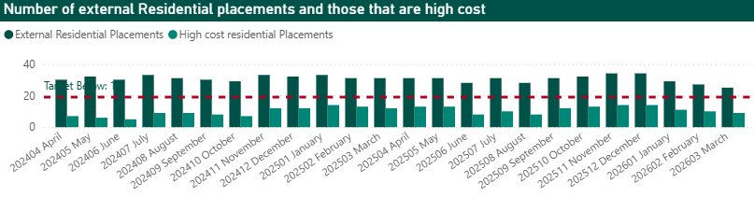
Children, Families, Health and Care – Placements – Where Our Children Live
High-cost residential placements are often used in emergency situations or for children with high-risk needs. Monitoring these placements helps us plan more effectively, manage costs, and explore more local, sustainable options. It also highlights the number of children placed in external residential settings, those not managed by Hillingdon which are significantly more expensive than in-house alternatives. To address and disrupt the market we have invested in increased local capacity, impact of which is being seen from February 2026 and expectation is for further improvement and reduction over the next financial year. By tracking this data, we aim to meet children’s needs while maintaining financial sustainability.

Slide 26
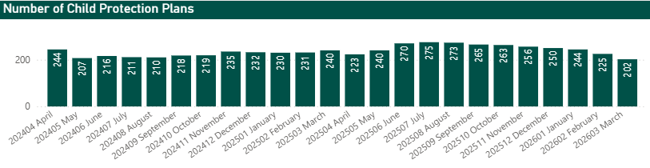
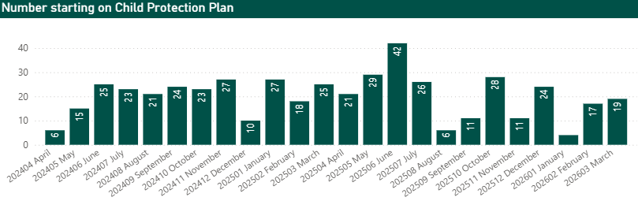
Children, Families, Health and Care – Child Protection Plans
Child Protection Plans (CPPs) are implemented when there is a significant concern that a child may be at risk of harm, including abuse, neglect, or other forms of abuse. These plans are developed through multi-agency collaboration and outline specific actions to safeguard the child and promote their overall wellbeing. They are reviewed regularly to ensure that the support provided remains appropriate and effective.
The top graph illustrates the total number of children subject to an active Child Protection Plan at the end of each month. Monitoring this figure helps us understand the overall level of safeguarding demand and informs workforce and resource planning.
The bottom graph shows the number of new Child Protection Plans initiated each month. Fluctuations in this data can indicate changes in local safeguarding pressures, such as increased risks within families or improved identification of harm through professional vigilance.
As of March 2026, there were 202 children with active Child Protection Plans, a decrease from 240 at the end of 2024/25.

Slide 27
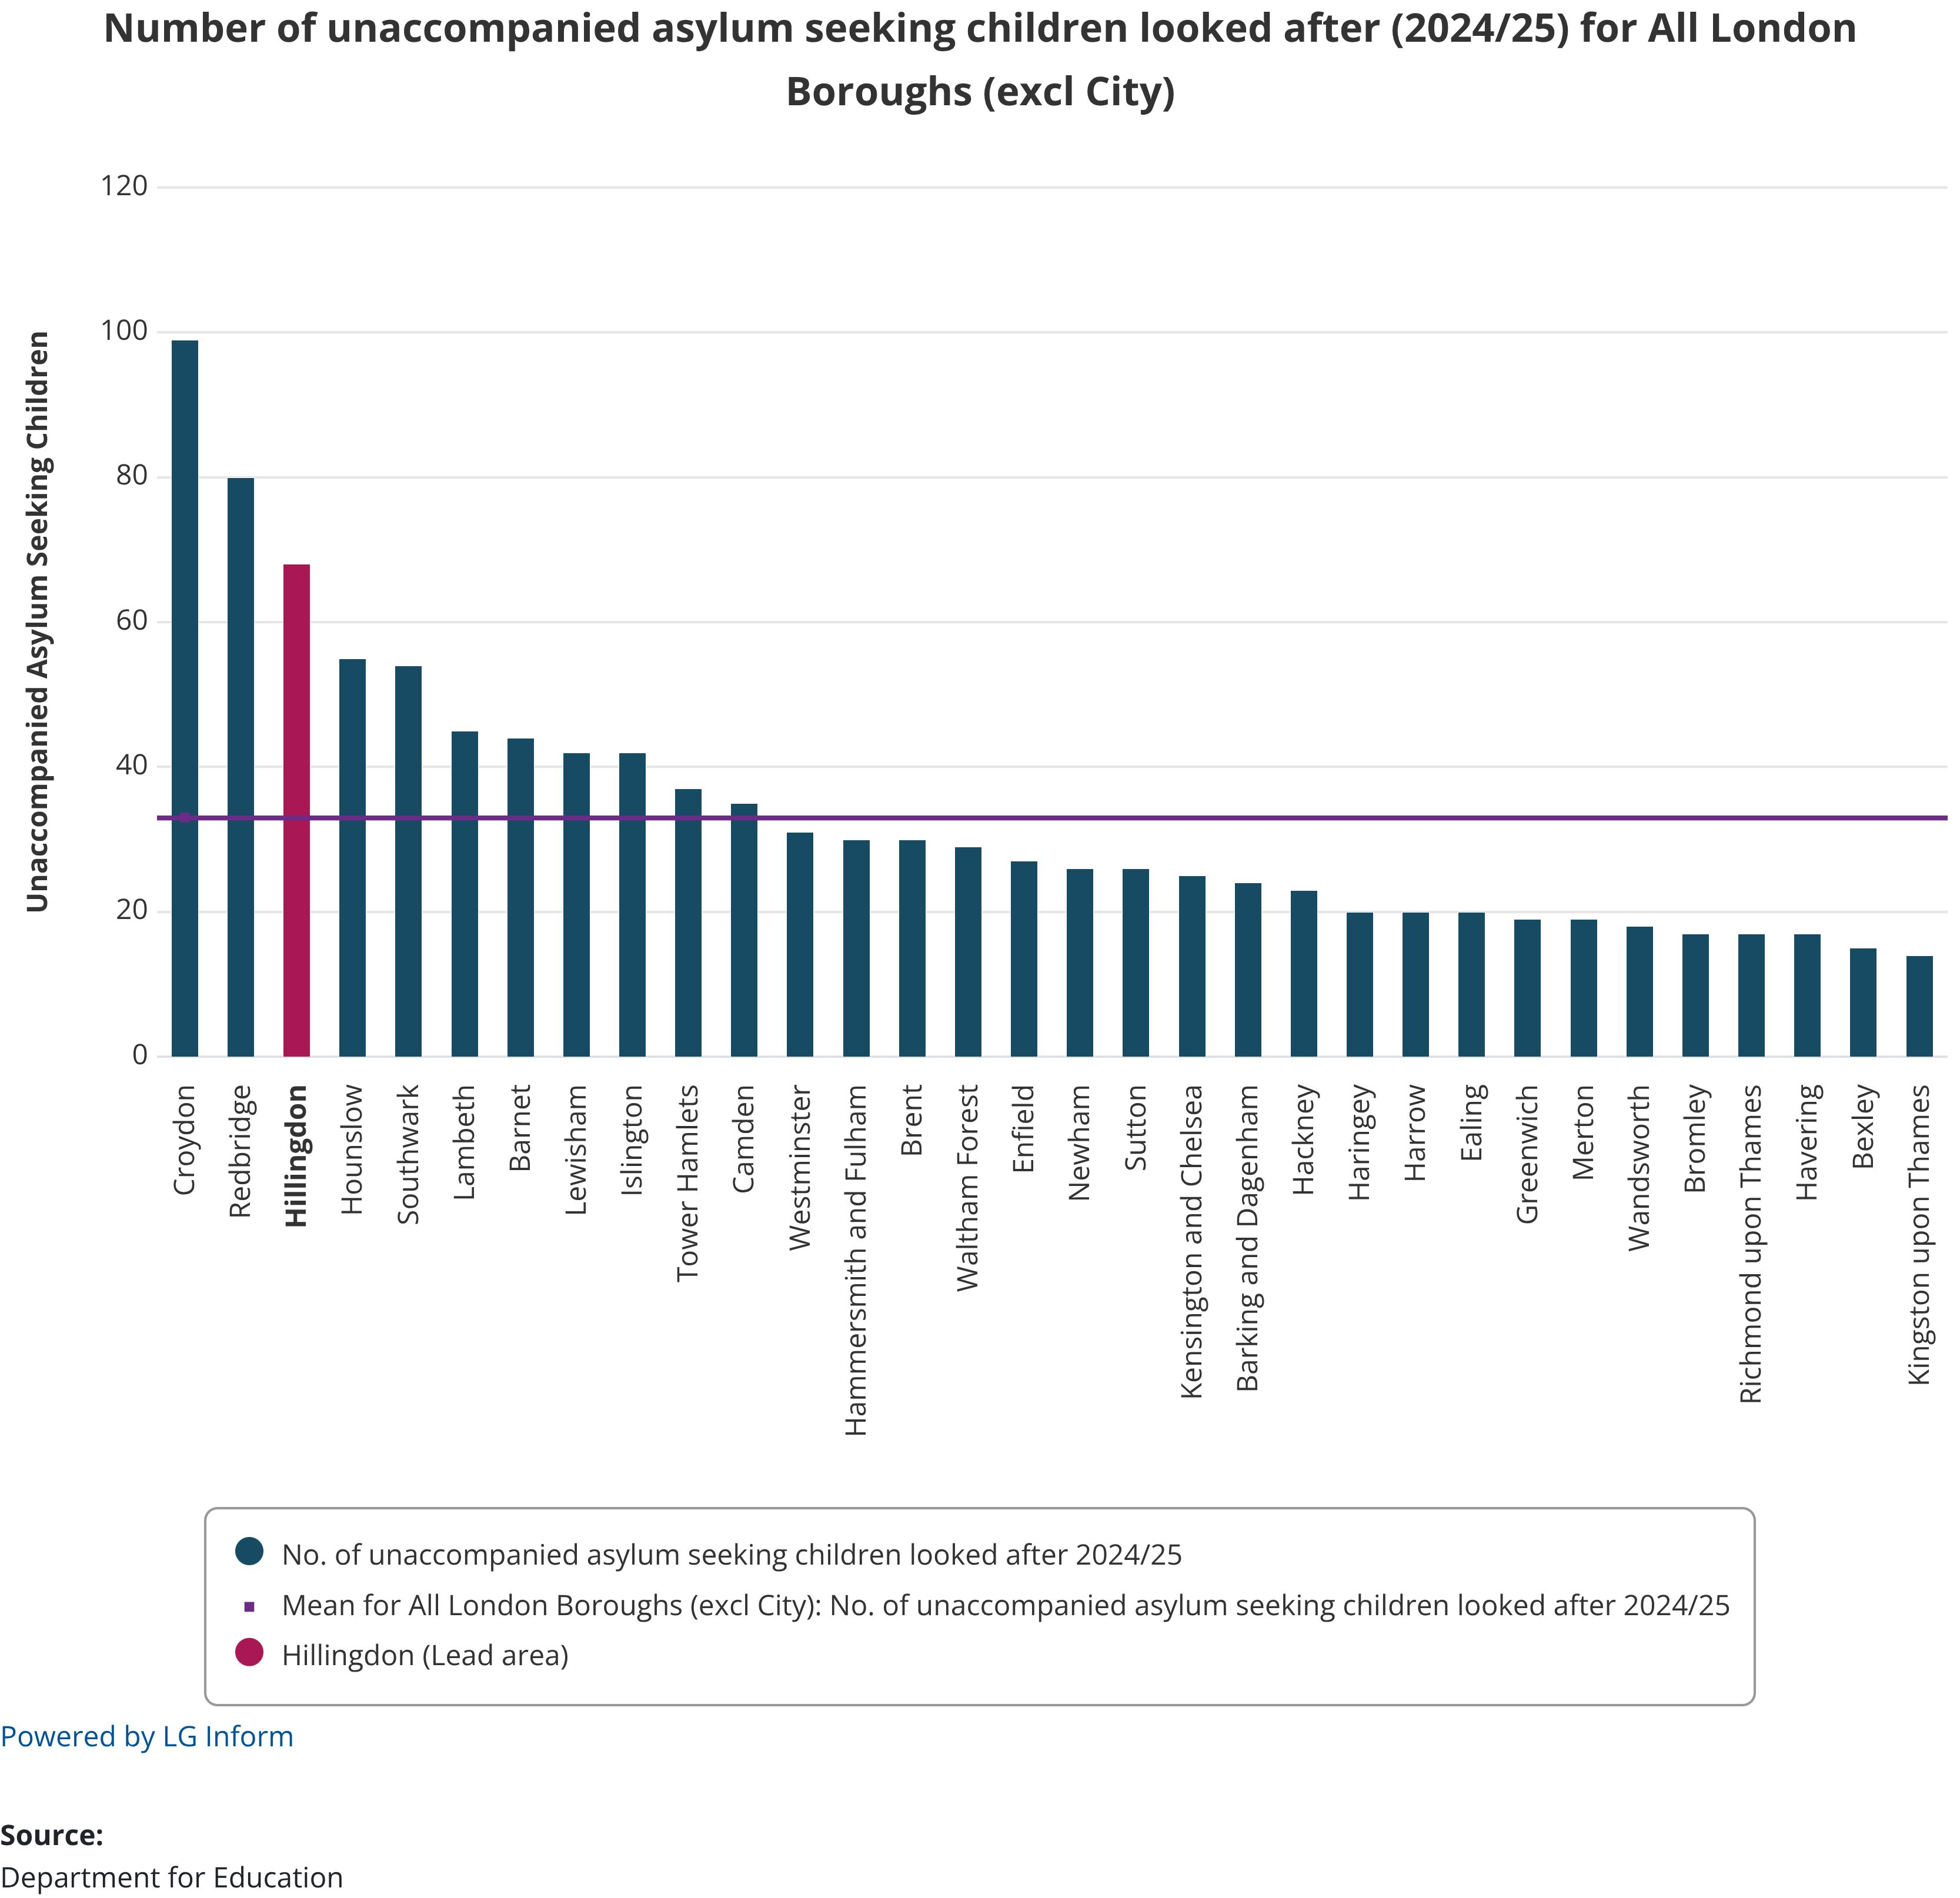
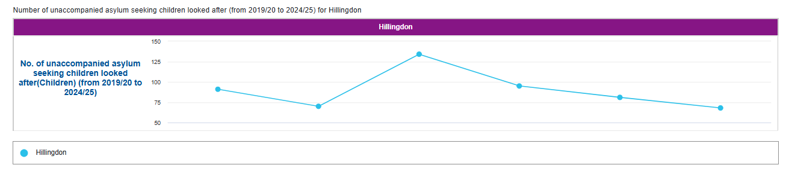
Children, Families, Health and Care – Unaccompanied Asylum-Seeking Children
As a port authority area, due to the presence of Heathrow Airport, Hillingdon continues to play a critical role in supporting unaccompanied asylum-seeking children (UASC). These young people arrive in the UK without a parent or guardian and therefore have significant vulnerabilities. Consequently, they require tailored support to ensure their safety, wellbeing and integration.
The graph on the left shows the number of UASC supported by each London borough in 2024/25. Hillingdon has the third highest number (68) when compared to other boroughs; the average in London is 32.
The National Transfer Scheme (NTS) enables the redistribution of UASC across local authorities to ensure a more equitable sharing of responsibility and to prevent disproportionate pressure on port authority areas like Hillingdon; under the NTS a number of UASC have been successfully transferred to other local authorities helping to manage local capacity while ensuring children continue to receive appropriate care. The numbers therefore don’t entirely reflect the activity as many more children receive a service prior to transfer to their permanent local authority.
Care costs for unaccompanied asylum seeking children are funded by central government.

Slide 28
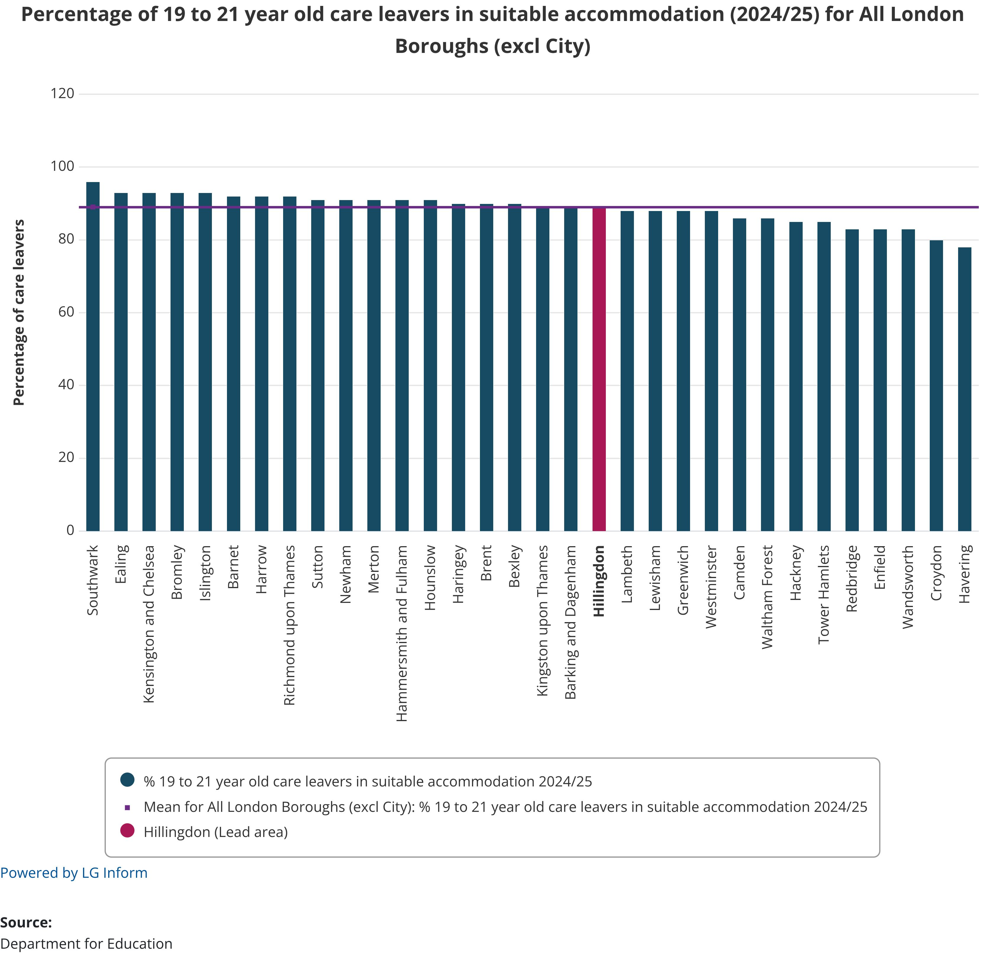
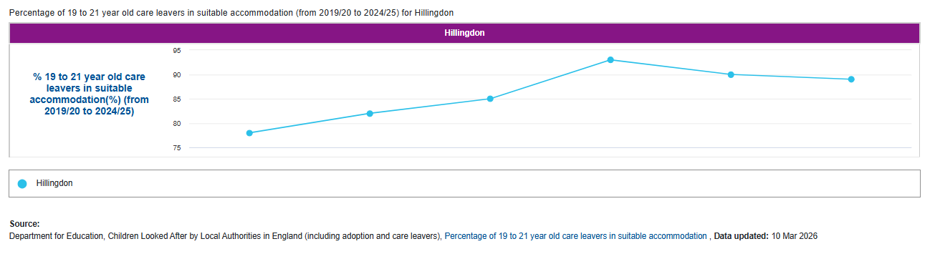
Children, Families, Health and Care – Care Leavers
Local authorities have a statutory duty to support care leavers, young people who have been in the care of the local authority, as they transition into adulthood. This support extends beyond the age of 18 and includes the provision of a personal adviser, pathway planning, and access to advice, emotional support, and practical assistance with housing, education, employment, training, and financial management. The duty continues until at least the age of 21, and in many cases up to age of 25, depending on the young person’s needs and level of engagement.
A key measure of this support is the suitability of accommodation provided to care leavers. Ensuring that young people have access to safe, stable, and appropriate housing is fundamental to their wellbeing and long-term outcomes. The graph on this page shows how each London borough performed in 2024/25.
As a port authority borough, Hillingdon supports a significantly higher number of care leavers than many other local authorities, due in part to the volume of UASC who enter care locally and later transition into care leaver status. This places additional pressure on housing, education, and support services. In response, Hillingdon continues to strengthen its care leaver offer, with a focus on increasing access to suitable accommodation, improving pathway planning, and ensuring young people are well supported to achieve independence and thrive in adulthood.

Slide 29
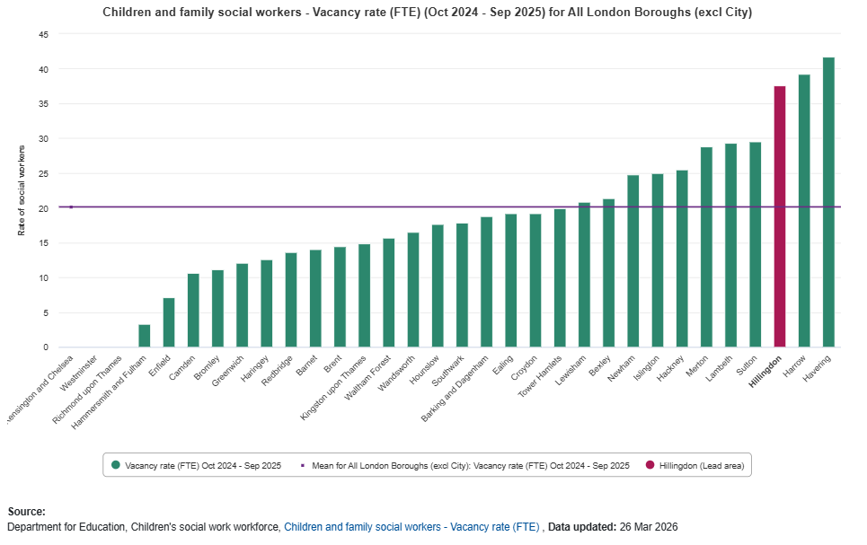
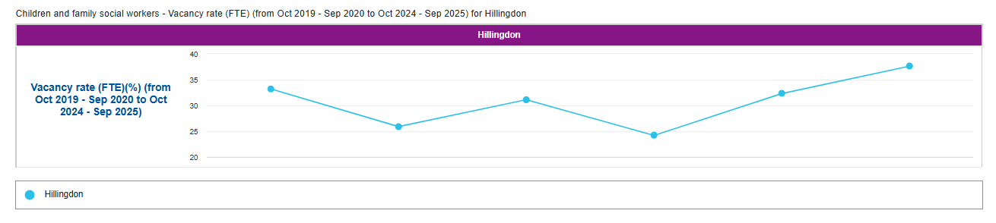
Children, Families, Health and Care – Social Worker Recruitment and Retention
Recruiting and retaining qualified children’s social workers remains a significant national challenge, driven by rising demand, high caseloads, and increasing competition across the sector. These pressures are particularly acute in areas like Hillingdon, where the complexity and volume of cases, especially linked to our role as a port authority, require a highly skilled and resilient workforce. Maintaining a stable and experienced team is essential for building trusted relationships with children and families, ensuring continuity of care, and delivering high quality, timely interventions.
The graph (top left) shows the latest published vacancy rates for children’s social workers across London. Monitoring these rates is critical for identifying workforce pressures and informing strategic planning. In Hillingdon, we have taken proactive steps to strengthen recruitment and retention, including the introduction of a refreshed workforce strategy, enhanced supervision and support structures, and targeted recruitment campaigns. We are also investing in professional development pathways and promoting Hillingdon as a place where social workers can thrive and make a meaningful impact.
Our social work vacancy rates are higher in the last year as we reduced the overall number of social worker posts from August 2025 as part of our revised social care delivery model aligned to The Families First Partnership Programme.

Slide 30
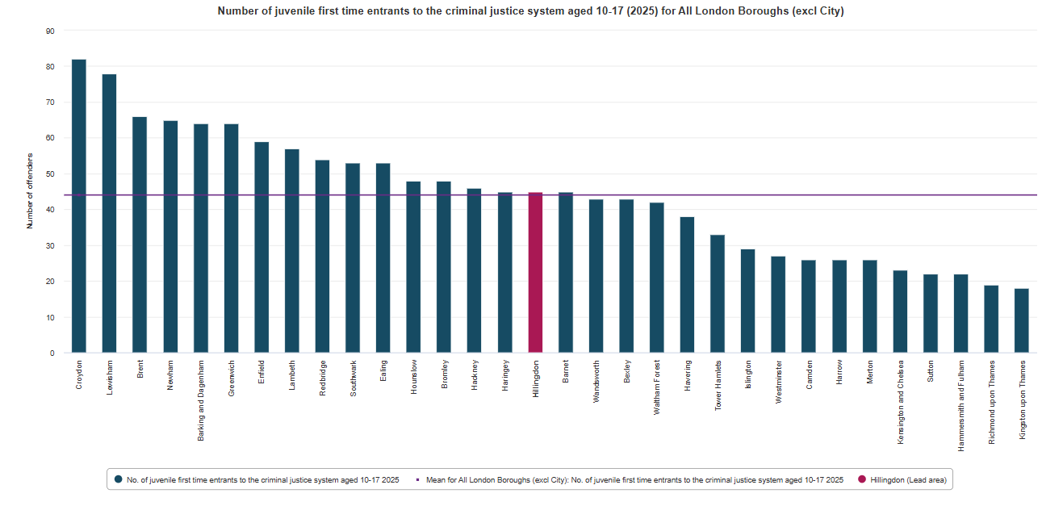
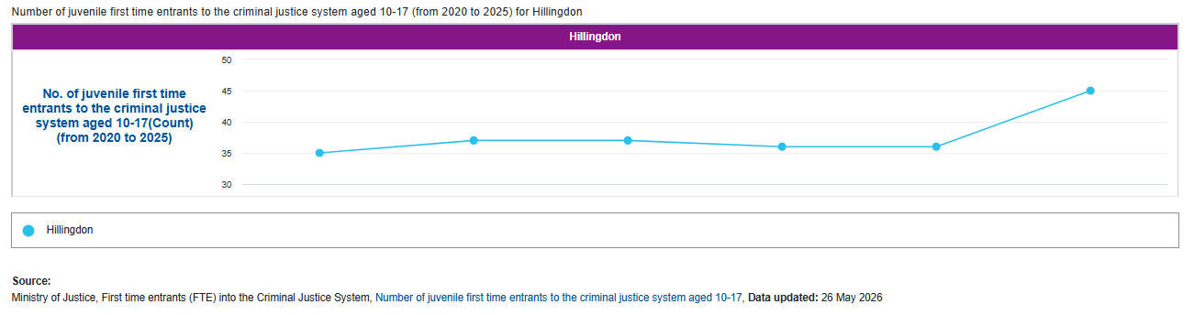
Children, Families, Health and Care – Early Contact with the Youth Justice System
In 2025, Hillingdon recorded 45 first-time entrants to the youth justice system, similar to the London average of 44.
This metric is a key indicator of how many children and young people are entering the criminal justice system for the first time, either through conviction or youth caution.
A lower rate of first-time entrants is often interpreted as a sign of effective early intervention and prevention strategies, reflecting the strength of local safeguarding partnerships and the proactive work of services across education, social care and health.
In Hillingdon, this positive trend aligns with the borough’s strategic commitment to a child first approach, which prioritises the rights, needs, and potential of children while aiming to divert them from formal justice pathways wherever possible.

Slide 31
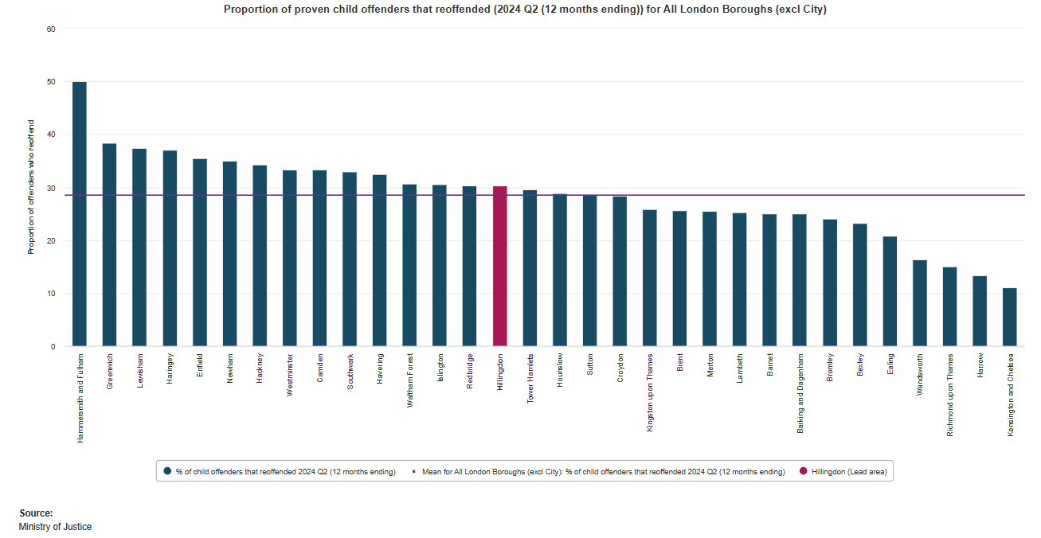
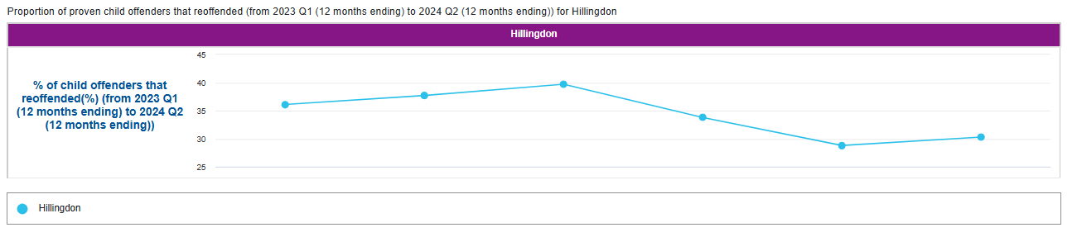
Children, Families, Health and Care – Youth Justice: Reoffending Rates
While the rate of first-time entrants is encouraging, it is important to note that reoffending rates remain a concern. In the 12 months to Q2 2024, 30.3% of young people known to have committed an offence in Hillingdon reoffended, above the London average of 28.5%.
This measure tracks the proportion of young people who commit a further proven offence within a year of a previous offence. A deep dive audit commissioned by the Youth Justice Strategic Partnership Board, identified that the majority of reoffending happened between the first offence and becoming known to Youth Justice Services.
Children in the youth justice system often face multiple and overlapping challenges, including social deprivation, trauma, discrimination, and unmet health needs. These factors underscore the importance of joined-up working across sectors, ensuring that interventions are not only timely but also holistic and tailored to individual circumstances.

Slide 32
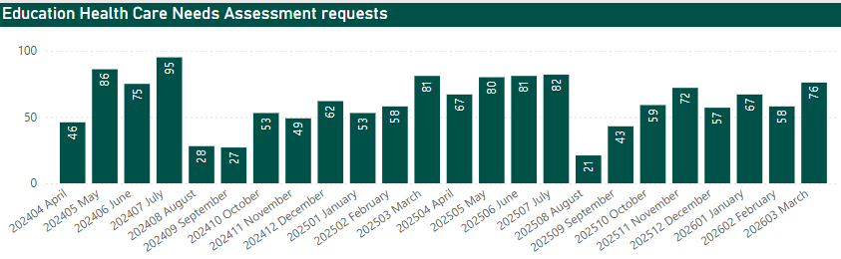
Children, Families, Health and Care - Children with SEND – Need Assessment
Education, Health and Care Needs Assessment (EHCNA) Requests are formal applications that trigger a multi-professional review of a child’s needs. Increasing numbers may indicate greater awareness, earlier identification, or growing demand for support, all contributing to timely and appropriate provision.
The year began with 67 requests and saw several peaks in demand, particularly in the early months. A noticeable dip occurred during the summer period, with numbers rising again in the latter part of the year. By the end of March 2026, the number of requests had increased to 76.

Slide 33
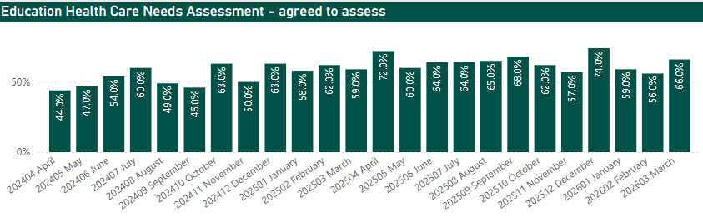
Children, Families, Health and Care - Children with SEND – Need Assessment
EHC Needs Assessments Agreed to Assess
The EHCNA Agreed to Assess stage reflects the council’s decision to proceed with a full Education, Health and Care Needs Assessment. This represents a formal commitment of professional and administrative resources to thoroughly assess and understand the child’s needs. Rising volumes increase pressure on council services. This demand also drives higher assessment and support costs, impacting overall budget sustainability.
At the start of the 2025/26 financial year, 72% of EHCNA requests were agreed to proceed to assessment in April. By the end of the year, this had decreased to 66% in March 2026. Agree to assess levels remained higher month-on-month compared to last year, indicating a higher proportion of requests being progressed to formal assessment. This suggests more appropriate requests are being received for assessment.

Slide 34
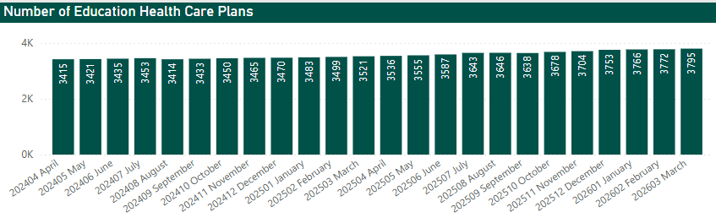
Children, Families, Health and Care – Children with SEND, EHCP Demand
We are tracking both the number of Education, Health and Care Plans (EHCPs) issued and the volume of Needs Assessment Requests. EHCPs define the tailored support that children and young people with SEND are entitled to, ensuring they have access to the appropriate education, health, and care services.
Number of Education Health Care Plans (EHCPs)
At the start of the financial year, there were 3,536 active EHCPs. During the year, the number steadily increased, reflecting continued demand for support. As of the end of March 2026, the total stood at 3,795 - representing an overall increase of approximately 7.3% compared to the start of the year, more than double the increase throughout 2024/25 (3.1%).

Slide 35
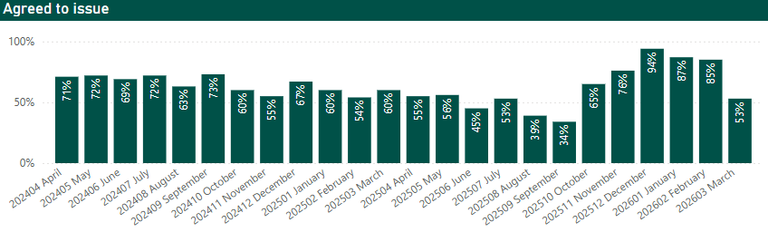
Children, Families, Health and Care – Children with SEND, EHCP Demand
The Agreed to Issue decision is made by week 16 of the process. This measure captures whether, following an Education, Health and Care Needs Assessment (EHCNA), the decision is to issue an EHCP. It reflects how often the council agrees that statutory support is needed and will be provided for a child or young person with SEND.
In 2025/26, the rate of agreed-to-issue decisions fluctuated during the year. Typically, this outcome does vary throughout the year.

Slide 36
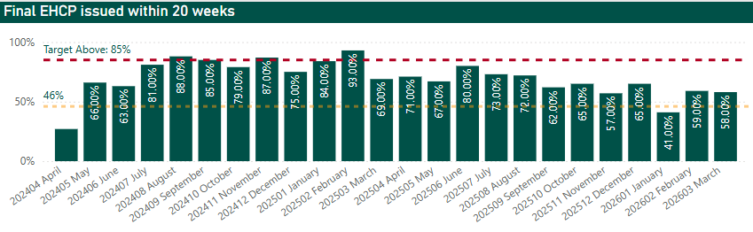
Children, Families, Health and Care – Final EHCP 20 Week Timeliness
This indicator tracks the percentage of final Education, Health and Care Plans (EHCPs) issued within 20 weeks of the initial request, in line with the statutory timescale set out in the SEND Code of Practice. Exemptions apply in limited cases (e.g. during periods of school closures), but in most circumstances, a plan should be completed within 20 weeks. A higher percentage reflects better timeliness and system responsiveness to children and young people with special educational needs.
At the start of the financial year 2025/26, 71% of final EHCPs were issued within 20 weeks. Timeliness has fluctuated throughout 2025/26 but then faced a dip by the end of March 2026. However, performance in March was above national average (46%).

Slide 37
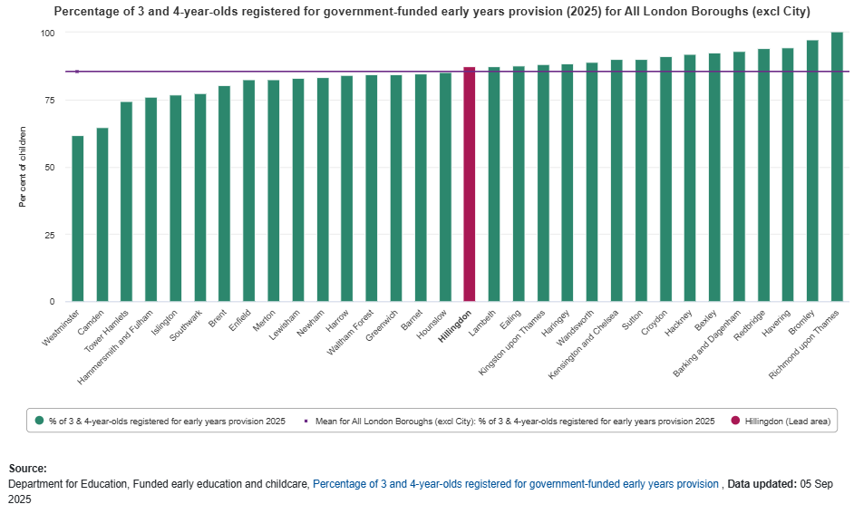
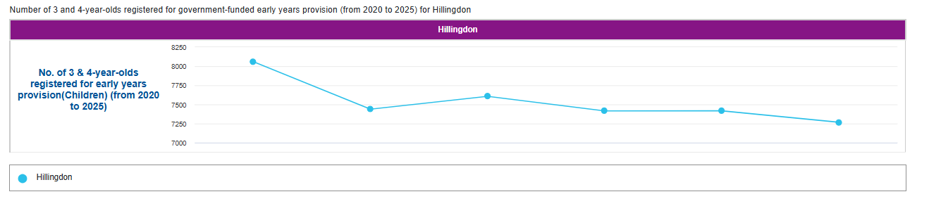
Children, Families, Health and Care – Funded Early Education for 3 and 4-Year Olds
In 2025, 87.3% of children aged 3 and 4 in Hillingdon were registered for government funded early years provision. Higher than the London average (85.4%).
This number reflects how many children in this age group are benefiting from the government’s offer of free early education, helping them get a strong start to their learning and development.
Providing funded early education supports children’s social, emotional, and cognitive skills, preparing them well for starting school.

Slide 38
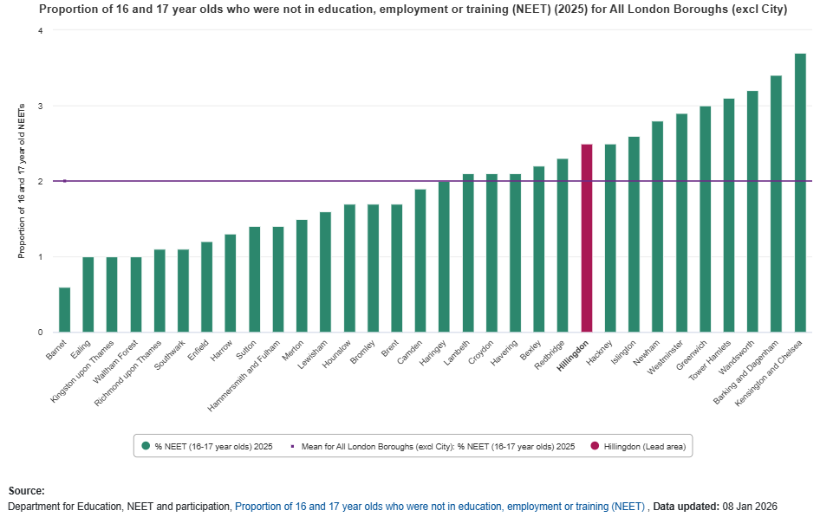
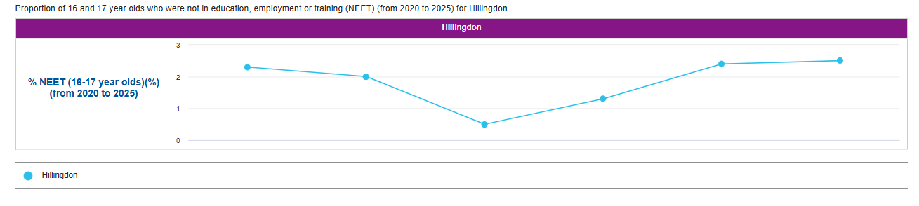
Children, Families, Health and Care - NEET Outcomes for 16–17 Year Olds
Percentage of Young People (16-17) Not in Education, Employment or Training (NEET)
In 2025, 2.5% of 16 and 17-year-olds in Hillingdon were not in education, employment or training (NEET). This is higher than the average for London (2%).
The chart compares Hillingdon’s NEET rate with other London boroughs, showing that while some areas perform better, a number of boroughs face even higher NEET rates.
Monitoring and addressing NEET levels is important to help young people access opportunities and support them to achieve positive outcomes. By focusing on this indicator, the council can work with local schools, employers, and training providers to help more young people in Hillingdon stay engaged and move into successful futures.

Slide 39
Corporate Director: Sandra Taylor, Adult Social Care and Health
Referrals into Adult Social Care are relatively steady, averaging 665 per month. Home-based support is becoming more complex — the number of unique clients receiving home care has fallen gradually, while the number of active services has increased, indicating more people are receiving multiple forms of support at once. Reablement is a key response — the council is using more short-term reablement support to help residents regain independence and reduce escalation into longer-term, higher-cost care.
Independent living remains a relative strength — 81.1% of adults aged 18–64 receiving long-term support were living in their own home or with family in 2024/25, slightly above the London average of 78.8%.
Residential and nursing support placements average 740 per month, while average support hours per resident on an adult support plan have stayed broadly stable, with an increase throughout the year from 58.1 to 66.1 hours of support given. The age profile of new entrants is consistent each month — an average of 42 in those aged 18–64, and 82 years in those aged 65+.
Assessment speed is a clear challenge — Adult Social Care has an internal target to complete 80% of new client assessments within 28 days, but the presentation states this has been missed consistently during the last two financial years. The service explicitly balances speed with quality — delays are partly attributed to complex needs, multi-agency coordination, and planned reviews, with the narrative emphasising triage and professional judgement rather than simple throughput. Completed assessment volume remains substantial — monthly assessment totals demonstrate sustained operational effort by social workers despite the timeliness gap. Overall implication — this is a capacity-and-complexity story rather than a collapse in delivery; the team is completing large volumes, but not always within the intended timeframe.
Service user experience - Quality of life scores are comparatively positive — in 2024/25, Hillingdon scored 19.1 out of 24 on the adult social care quality-of-life measure, above the London average of 18.6. Overall satisfaction is broadly in line with London — the borough scored 62% for satisfaction with care and support, close to the London average of 61.2%.
Perceived control over daily life is another strong area — 75.2% of surveyed service users reported having adequate or as much control over daily life as they wanted, compared with 72.5% across London. Taken together, these measures suggest decent lived experience — despite pressure on assessments and increasing complexity, users generally report good outcomes and a sense of autonomy.
Carer experience and workforce stability
Carer quality-of-life outcomes are weaker than peers — Hillingdon scored 6.8 out of 12 for carer-related quality of life in 2024/25, below the London average of 7.2.
Carer satisfaction with services is stronger — 36.3% of carers were extremely or very satisfied with support and services, above the London average of 33.0%.
This creates an important contrast — carers seem somewhat more satisfied with services than peers in other boroughs, but their own overall wellbeing remains lower.
Workforce turnover is a positive signal — staff turnover in the formal care workforce was 14.9% in 2024/25, well below the London average of 20.1%, which the presentation links to stronger continuity and better outcomes.
Public Health: Childhood weight and adult physical activity
Reception-age prevalence is comparatively better — 19.9% of children in Reception were overweight or living with obesity in 2024/25, lower than both London and England
The picture worsens by Year 6 — prevalence rises to 36.2% by Year 6, a gap of 16.3 percentage points from Reception, which is similar to London but higher than the England gap.
Childhood obesity as a major long-term health risk and notes it as a priority for the local health and wellbeing strategy through 2025–28.
Adult inactivity — 30.8% of adults were physically inactive in 2024/25, significantly worse than the London average of 21.9%.

Slide 40
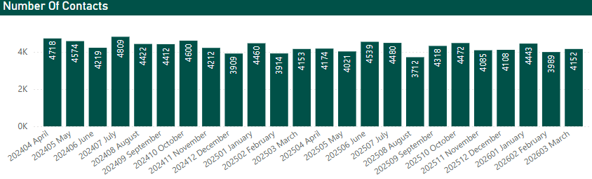

Children, Families, Health and Care - Adult Social Care Demand
Adult Social Care’s front door is managing high volumes while maintaining strong control of demand through effective triage. Most contacts are resolved at first point or through existing services, ensuring statutory intervention is targeted appropriately.
Over the period, 57,482 contacts were managed (around 4,100 per month), with only 16% progressing to a new referral. The majority were either linked to existing client records (42%) or resolved at first contact (36%).
Demand is appropriately focused on statutory and higher-risk activity, including Care Act assessments and safeguarding, alongside hospital discharge, equipment, Deprivation of Liberty Safeguards and Mental Health Act work.
Overall, this reflects a well-managed, high‑volume service that is delivering the right response, meeting Care Act duties, and focusing resources on residents with the greatest need.

Slide 41


Children, Families, Health and Care - Adult Social Care Demand
Community long‑term support is characterised by increasing complexity, with more residents requiring coordinated, multi‑service packages. Currently, 2,521 people are supported through 3,978 services (c.1.6 per person), with long durations (c.2 years) reflecting sustained reliance on community provision, which accounts for around 75% of all activity.
Demand is increasingly shaped by complexity, with higher reliance on combined support across home care, direct payments, supported living and outreach. This is driving both cost and delivery pressure across the system.
Targeted use of reablement and digital tools such as AskSARA is strengthening early intervention and self-directed support, helping residents maintain independence and reducing avoidable escalation into long-term provision.
Community services now form the backbone of Adult Social Care delivery. Performance, flow and financial grip are increasingly dependent on sufficient community capacity and stability. Demand remains structurally embedded, with core cohorts (physical care, learning disability and mental health) requiring long‑term support and limited natural exit without active intervention.

Slide 42

Children, Families, Health and Care - Adult Social Care
Performance data shows that in 2024/25, 81.1% of adults aged 18–64 receiving long‑term support were living in their own home or with family, which is above the London average of 78.8%.
This indicates that Hillingdon is performing well in the London region in enabling independent living, with a higher proportion of residents supported outside of institutional settings. The data suggests that current approaches, including community‑based support and reablement, are contributing to residents maintaining independence and stability.
Higher performance in this measure reflects a system that is successfully supporting people to remain in familiar environments, reducing reliance on more intensive forms of care, and improving overall outcomes for residents and reducing costs.

Slide 43



Children, Families, Health and Care - Adult Social Care Demand
The top graph shows the number of monthly contacts by age range 18-64 and 65+. Contacts average 4,000 to 4,500 per month, with those aged 65+ driving more demand.
The middle chart shows the average age within those ranges, with the 65+ cohort accounting for the larger share of contacts in most months.
Average ages are very stable — within each age band, the average age barely changes over time:
18–64, around 42 years
65+, around 82 years
The age profile is predictable — while contact counts fluctuate modestly, the underlying age mix within each band remains highly consistent.
The bottom chart shows how many people aged over 85 have contacted adult social care services each month. The numbers are showing a downward trend in 2025/26.

Slide 44


Children, Families, Health and Care - Adult Social Care Assessments
Adult Social Care ensures that everyone contacting the service is triaged at the point of contact, enabling an immediate response to risk, need and urgency. This approach supports timely decision‑making and ensures that residents receive the right advice, intervention or onward allocation at the earliest opportunity.
The service monitors the completion of Care Act assessments, with a locally agreed operational target for them to be completed within 28 days of referral. This measure relates to the full completion of assessments rather than initial response and is not a statutory requirement under the Care Act 2014.
Performance against this target is influenced by operational factors including case complexity, multi‑agency involvement, and specific cohorts such as hospital pathways and individuals subject to the Mental Health Act. While not all assessments are completed within the 28‑day timeframe, residents are routinely seen, risk assessed and supported earlier in the process, with priority given to those with the greatest need.
This demonstrates overall a responsive and well‑managed service that is effectively balancing demand, complexity and timeliness, while maintaining a clear focus on safety, proportionality and person‑centred practice.
The graph shows the volume of Adult Social Care assessments completed each month, demonstrating the scale of activity undertaken across the service.
This sustained level of delivery reflects the ongoing work of teams managing high volumes of demand, progressing complex cases and ensuring that residents receive appropriate support. It also highlights the role of professional judgement in balancing timeliness with quality, with interventions often initiated at an earlier stage while formal assessment processes are completed.

Slide 45


Children, Families, Health and Care - Adult Social Care Service User Survey Responses (1)
Every year, a survey is sent to randomly selected service users. This provides an excellent way for service users to feed back on a multitude of topics. It’s also helpful for Hillingdon and the government to understand service users’ views so that services can continue to be improved.
This measure is an average quality of life score based on responses to the Adult Social Care Survey. It is a composite measure using responses to survey questions covering the eight domains identified in the Adult Social Care Outcome Framework (ASCOF): control, dignity, personal care, food and nutrition, safety, occupation, social participation and accommodation.
In 2024/25, Hillingdon scored 19.1 out of 24, based on responses to surveys sent to service users; the average for London was 18.6.
The higher the score, the better quality of life.
‘Service users’ definition:
People receiving partly or wholly supported care from their local authority and not wholly private, self-funded care.

Slide 46


Children, Families, Health and Care - Adult Social Care Service User Survey Responses (2)
Every year, a survey is sent to randomly selected service users. This provides an excellent way for service users to feed back on a multitude of topics. It’s also helpful for Hillingdon and the government to understand service users’ views so that services can continue to be improved.
It’s important that service users’ satisfaction with care and support is as high as possible.
In 2024/25, Hillingdon scored 62%, for social care-related satisfaction with care and support, based on responses to surveys sent to service users; this is similar to the London average of 61.2%.
The higher the score, the more satisfied.
Score based on those responding:
'I am extremely satisﬁed’ or
'I am very satisﬁed’
to 'Overall, how satisﬁed or dissatisﬁed are you with the care and support services you receive’
and those responding:
'I am very happy with the way staﬀ help me, it's really good’
to 'How happy are you with the way staﬀ help you?‘
‘Service users’ definition:
People receiving partly or wholly supported care from their local authority and not wholly private, self-funded care.

Slide 47


Children, Families, Health and Care - Adult Social Care Service User Survey Responses (3)
Every year, a survey is sent to randomly selected service users. This provides an excellent way for service users to feed back on a multitude of topics. It’s also helpful for Hillingdon and the government to understand service users’ views so that services can continue to be improved.
It’s important that service users have as much control over their daily life as possible.
In 2024/25, Hillingdon scored 75.2%, for those service users who reported having control over their daily life, based on responses to surveys sent to service users, higher than the London average of 72.5%.
The higher the score, the more service users had control.
Score based on those responding:
‘I have as much control over my daily life as I want’ or
‘I have adequate control over my daily life’ to: ‘Which of the following statements best describes how much control you have over your daily life?’
‘Service users’ definition:
People receiving partly or wholly supported care from their local authority and not wholly private, self-funded care.

Slide 48


Children, Families, Health and Care - Adult Social Care Carer Survey Responses (1)
Carer-reported quality of life
Every two years, a survey is sent to randomly selected carers. This provides an excellent way for carers to feed back on a multitude of topics. It’s also helpful for Hillingdon and the government to understand carers’ views so that services can continue to be improved.
In 2024/25, Hillingdon scored 6.8 out of 12, for carer-related quality of life, based on responses to surveys sent to carers, lower than London (7.2).
The higher the score, the better quality of life.
The score takes into consideration:
-occupation
-control
-personal care
-safety
-social participation
-encouragement/support.
‘Carer’ definition:
Person providing unpaid support, where they have:
-received ongoing support during the year, even if no review of those arrangements took place
And/or
-have been assessed or reviewed for support during the year, even if no support was provided.

Slide 49


Children, Families, Health and Care - Adult Social Care Carer Survey Responses (2)
Overall satisfaction of carers with social services
In 2024/25, Hillingdon achieved a carer satisfaction score of 36.3% for care and support services—based on survey responses from carers. This is above the London average of 33.0%, indicating relatively higher satisfaction among local carers.
The score reflects those who responded with 'extremely satisfied' or 'very satisfied' to the question: “Overall, how satisfied or dissatisfied are you with the support or services you and the person you care for have received from Social Services in the last 12 months?”
The term ‘carer’ refers to individuals providing unpaid support who either received ongoing support during the year (even without a formal review) or were assessed or reviewed for support (even if no support was ultimately provided).

Slide 50

Children, Families, Health and Care - Adult Social Care Staff Turnover
In 2024/25, Hillingdon’s proportion of staff in the formal care workforce leaving their role was 14.9%, below the London average of 20.1%.
It is based on directly employed staff only, agency staff are not included in these estimates. Higher staff leaver rates indicate that a greater share of social care staff have left their roles in the previous 12 months.
A lower turnover rate reflects greater workforce stability and consistency, which supports better outcomes for residents.

Slide 51


Children, Families, Health and Care – Public Health, prevalence of overweight (including obesity) in Reception aged children
There is concern about the rise of childhood obesity and the implications of obesity persisting into adulthood.
The risk of obesity in adulthood and risk of future obesity-related ill health are greater as children get older. Studies tracking child obesity into adulthood have found that the probability of children who are overweight or living with obesity becoming overweight or obese adults increases with age.
The health consequences of childhood obesity include Type 2 Diabetes, hypertension and the exacerbation of conditions such as asthma and psychological problems such as social isolation, low self-esteem, teasing and bullying.
19.9% of Reception children were overweight or living with obesity in 2024/25, lower than both London and England.

Slide 52


Children, Families, Health and Care – Public Health, prevalence of overweight (including obesity) in Year 6 children
Year 6 prevalence of overweight (including obesity) was 36.2% in 2024/25; this represents a difference of 16.3 percentage points from Reception to Year 6, similar to London but higher than England differences (16.2 and 12.7).
Hillingdon’s trend is below England for Reception but above England for Year 6. Reducing childhood obesity is a strategic priority for Hillingdon’s Health and Wellbeing Board throughout 2025-28.

Slide 53


Children, Families, Health and Care – Public Health, physical activity (adults)
This is the percentage of respondents aged 19 and over, doing less than 30 moderate intensity equivalent (MIE) minutes' physical activity per week in bouts of 10 minutes or more in the previous 28 days expressed as a percentage of the total number of respondents.
In 2024/25, the percentage of physically inactive adults in Hillingdon was 30.8%, above the London average of 21.9%.

Slide 54


Our commitments to residents
Cabinet Member: Cllr Adam Bennett
Portfolio: Community, Environment and Enforcement
Safe and strong communities
A green and sustainable borough

Slide 55
Corporate Director: Dan Kennedy, Residents Services
Green spaces and trees - Both the green spaces and trees slides describe a year-on-year reduction in resident service requests, suggesting maintenance activity is starting to reduce the volume of issues being reported. For green spaces, the main request categories remain overgrowth and weeds; for trees, the dominant issues are branches and tree health, with fewer requests about roots. The reduction in enquiries is due to better targeting of common issues, and, in the case of trees, support from an updated tree policy.
Anti-social behaviour (ASB) and crime - Anti-social behaviour remains persistently high — monthly ASB enquiries average over 600 per month, with some seasonal variation but no real sign of a sustained drop. Relative performance is better than London overall — despite the high absolute numbers, Hillingdon has consistently lower rates than the London average. Crime levels are also high and fairly stable — recorded crime averages around 2,600 incidents per month, fluctuating month to month but without a major directional shift.
Residual waste and recycling performance - Residual household waste rates are higher than average when lower rates are preferred — Hillingdon collected 532 kg per household in 2024/25, above the London average of 487 kg. Recycling and composting performance is a stronger area — Hillingdon records 37% of household waste sent for recycling and composting, ahead of the London average of 32%. Food waste separation is slightly ahead of average — the food composting slide reports 4.5%, just above the London average of 4%, with improvement efforts focused on trials in blocks of flats and resident education campaigns. In summary, the borough appears to be doing better on selected recovery streams like recycling and composting, but produces a higher level of residual waste overall.
Fly-tipping enforcement - Enforcement activity is exceptionally low relative to London — Hillingdon records 24 enforcement actions per 1,000 incidents, compared with a London average of 638.9. Data coverage is part of the caveat — the incidents shown are only those reported to the local authority and exclude incidents reported directly to the Environment Agency. What it means in practice — this is presented less as a clean performance judgment and more as a reminder that enforcement statistics need context before drawing conclusions.

Slide 56

Community, Environment and Enforcement – Green Spaces
Fewer service requests about green spaces suggest improvements are making a real impact.
This chart shows a year-on-year reduction in service requests related to green spaces - such as overgrowth, weeds, grass cutting, and parks. Most requests in 2025/26 focused on overgrowth and weeds, but the overall decline points to more effective maintenance and positive outcomes for residents.
By targeting the most common issues and listening to community feedback, the council has reduced new reports and helped keep parks and green areas cleaner, better maintained, and more enjoyable for everyone.

Slide 57

Community, Environment and Enforcement – Trees
Fewer tree-related service requests suggest positive progress in local tree management.
This chart shows the trend in service requests regarding trees - covering issues like branches, tree health, and roots. Most requests in 2025/26 focused on branches and health, with fewer concerns about roots.
The overall reduction in reports indicates that the council’s proactive approach is working assisted by an updated tree policy. By targeting the most common issues, the council has improved response and maintenance - helping to keep Hillingdon’s trees healthy, safe, and enjoyable for all. This approach is being actively applied in 2026/27.

Slide 58


Community, Environment and Enforcement – Anti-Social Behaviour (ASB)
Everyone deserves to feel safe in their community.
This chart shows the monthly anti-social behaviour (ASB) cases reported. Despite seasonal ups and downs, case numbers stayed consistently high - averaging over 600 per month.
Sharing this data keeps residents informed, fosters transparency, and empowers targeted community action to tackle persistent issues.
Hillingdon has consistently recorded lower rates than the London average.
Hillingdon’s rates decreased in the first half of the year but show a peak in October; rates then started to decrease throughout the rest of 2025, with 2026 now showing an increase.

Slide 59

Community, Environment and Enforcement - Crime
Everyone deserves to feel secure in their community. This chart shows monthly recorded crime volumes for the 2025/26 financial year. While figures fluctuated month to month, overall crime levels remained high—averaging 2,600 incidents a month. Sharing this data raises awareness, promotes accountability, and supports evidence-based crime prevention strategies.
The bottom chart compares 12-month rolling crime rates in Hillingdon and the London average, where both areas follow a similar, relatively stable pattern over time. Crime levels in both areas highlight the ongoing need for sustained prevention efforts and active community engagement.

Slide 60


Community, Environment and Enforcement – Household waste (kg per household)
Household waste levels impact both the environment and local services.
This chart shows residual household waste per household (kg) collected by each London borough in 2024/25. Hillingdon collected 532 kg per household, above the London average of 487 kg per household.
Higher waste volumes suggest greater environmental pressure and increased demand on local infrastructure. Reducing waste through recycling, reusing, and mindful consumption is key to keeping Hillingdon cleaner, greener, and more sustainable.

Slide 61


Community, Environment and Enforcement – Household waste sent for reuse, recycling and composting
Our reuse, recycling and composting performance is helping reduce emissions and protecting natural resources.
This top chart shows the percentage of household waste sent for reuse, recycling and composting—such as food and garden waste—across London boroughs in 2024/25. Hillingdon’s value of 37% is above the London average (32%).
Hillingdon’s strong performance in this area supports a cleaner, greener borough by cutting emissions and making better use of natural resources.

Slide 62


Community, Environment and Enforcement – Food composting
Recycling performance is key to reducing environmental impact and waste disposal costs.
This chart shows the percentage of household waste collected separately as food waste in 2024/25. Hillingdon, marked in red collected 4.5%, just above the London average of 4%.
To improve recycling rates and reduce contamination, Hillingdon is trialling new recycling bins in selected flat blocks, supported by targeted education to encourage correct usage.
This initiative, alongside community events, features in Hillingdon People magazine, marketing campaigns, and direct communications, aims to raise awareness, foster better habits, and boost both the quality and quantity of recyclable materials collected.

Slide 63


Community, Environment and Enforcement – Fly-tipping
Fly-tipping is a complex issue influenced by multiple local factors.
This chart shows the total number of fly-tipping enforcement actions per 1,000 incidents in 2024/25. Hillingdon’s rate is 24 (per 1,000) well below the London average of 638.9 and one of the lowest in the region.
Incidents included here are those reported by each Local Authority and do not include incidents reported by the Environment Agency.
For these reasons, boroughs should not be judged as ‘good’ or ‘poor’ performers based solely on incident numbers. A more nuanced understanding is essential for effective response and prevention.

Slide 64

Cabinet Member: Cllr Richard Mills
Portfolio: Corporate Services, Digital and
Transformation
Our commitments to residents
A thriving economy
A digital-enabled, modern, well-run council

Slide 65
Corporate Director: Matthew Wallbridge, Chief Operating Officer
Cyber threats remain persistent and volatile — the cyber security slide describes monthly attack attempts rising and falling, with periodic spikes rather than a steady decline, which suggests the council is operating in a constantly changing threat environment. Phishing is the higher-volume risk — phishing attempts are described as much more frequent, at times exceeding 7,000 per month, even if recent months have been lower. Mitigations are in place with learning and development across the organisation, as well as a secure technology infrastructure to block threats.
Contact centre and telephone demand - Phone demand has fallen compared with the previous year — the resident calls slide says 2025/26 saw fewer total calls handled by our contact centre. Abandoned call rates remain a pressure point — although total call volumes are down, the percentage of abandoned calls has been higher in some months of 2025/26. The transition towards digital channels continues but show that phone-based access still matters and service quality over that channel remains important.
Website usage patterns - Web traffic fluctuates rather than rising smoothly — website usage is described as moving up and down throughout the year.
An average of 34,000 online forms are received every month; over 50% we assist the resident with completion.
What this likely means — website usage remains a key indicator of digital engagement; fluctuation may signal either changing resident behaviour, seasonal factors, or an area needing closer review.
Resident connectivity – broadband and speed. Digital connectivity across Hillingdon has improved significantly, with 95.08% of premises now having access to gigabit broadband, meaning the vast majority of residents and businesses can connect to ultra-fast internet services.

Slide 66

Corporate Services, Digital and Transformation – Cyber Security
The first chart tracks cyber threats—these are attempts by criminals to break into council systems, steal information, or disrupt services. The numbers go up and down each month, but there are periods where attacks spike, showing that the threat is always changing and never goes away.
The second chart shows phishing threats, which are attempts to trick people into giving away personal details or passwords, often by email. These attempts are much more common, sometimes reaching over 7,000 a month, but they’ve been lower in some recent months, showing how constant and widespread these risks are.
Why does this matter? Protecting against cyber and phishing attacks keeps council services running, protects sensitive information, and helps prevent fraud. The council’s security teams are always working in the background to spot and block these threats, keeping both staff and residents safe from online crime.
Staying alert to these dangers is important for everyone. The council’s ongoing work to defend its systems helps make sure residents’ data stays secure and services remain reliable.

Slide 67


Corporate Services, Digital and Transformation – Resident Connectivity
Resident connectivity – broadband and speed. Digital connectivity across Hillingdon has improved significantly, with 95.08% of premises now having access to gigabit broadband, meaning the vast majority of residents and businesses can connect to ultra-fast internet services. This places the borough in a strong position to support digital access, online services, and economic activity. Alongside this, average broadband speeds have increased sharply over time, with recent results showing speeds reaching over 270 Mbps. This continued growth reflects the shift towards full fibre connections, with around 63% of connections now using FTTH (full fibre), supporting faster and more reliable performance.
These improvements mean residents are better able to access online services, work remotely, and engage with digital council services. While a small proportion of areas still have lower coverage or speeds, the overall trajectory shows strong digital infrastructure and continued investment in connectivity across the borough

Slide 68

Corporate Services, Digital and Transformation – Resident Self Service
This chart shows the number of online forms completed by residents through the council’s website each month - a key measure of how people are using digital self-service to access council services.
We receive an average of 34,500 forms each month; In over 50% of cases, we assist the resident with completion.
Using digital services helps residents get things done quickly and easily, without needing to call or visit the council. It also reduces pressure on frontline staff, allowing the council to focus more resources on those who need the most support.

Slide 69


Corporate Services, Digital and Transformation – Resident calls handled
These charts show how many calls the contact centre handled from residents each month, as well as the percentage of calls that were abandoned (where callers hung up or dropped the call before getting through).
2025/26 saw fewer total calls coming into the contact centre compared to last year. This could mean that more residents are finding answers online or using other digital services, which can be quicker and more convenient for everyone.
However, the percentage of abandoned calls has been higher in some months in 2025/26; the council continues to work on improving the service - making it easier for residents to get through and get the help they need. Fewer total calls and the ongoing push to improve digital access both help reduce waiting times and free up staff to support residents with more complex enquiries.
Overall, these trends reflect the growing use of online services in Hillingdon, as well as the council’s commitment to making it easier for everyone to contact us, whether by phone or online.

Slide 70
Corporate Services, Digital and Transformation – Web usage
The number of visits to the Hillingdon Council website is a useful way to see how residents are using online services. This chart shows that website usage goes up and down throughout the year, with a sharp decrease in the last quarter of 2025/26.
Improved web usage means that more people are able to get the help they need quickly and easily, without having to phone or visit the council in person. By making sure the website is clear and easy to use, the council is helping residents find what they need, when they need it.

Slide 71

Member Enquiries
The chart shows the number of Member Enquiries (MEs) made each month, comparing this year and last year. MEs are questions or requests for information that residents raise with their local councillors—sometimes about problems with council services, sometimes just for more details about a situation.
The number of enquiries that are made demonstrates how often Members are requesting assistance to resolve resident queries. The council aims to respond to these enquiries within 10 working days, which helps make sure that any issues or questions Members raise are dealt with promptly.
Tracking these numbers over time helps the council improve services.

Slide 72

Our commitments to residents
Cabinet Member: Cllr Eddie Lavery
Portfolio: Finance
A thriving economy
A digital-enabled, modern, well-run council

Slide 73
Finance - Counter Fraud Recovery
Counter fraud performance is well above target — the council recovered £12.8 million in 2025/26, significantly ahead of the £8.8 million target. Operational activity is substantial — the same slide reports 113 fraud recoveries and 36 emergency housing units closed, releasing homes and resources back into use. This is one of the clearest positive performance stories in the section, showing tangible financial value from fraud detection across housing, business rates, and adult social care.
This graph highlights the council’s counter fraud activity across a range of services, including housing, business rates, and adult social care. Fraud in these areas can include false housing claims, undeclared business activity, and misuse of care funding.
In 2025/26, the council recovered a total of £12.8 million, significantly exceeding its target of £8.8 million. This reflects strong performance in identifying, investigating, and stopping fraudulent activity, and reclaiming funds and assets.
In 2025/26 the Counter Fraud Service had 113 fraud recoveries, and 36 emergency housing units closed helping to release vital homes and resources back into the system.
Counter fraud checks play a crucial role in protecting public money, ensuring fairness, and making sure support reaches those who are genuinely eligible.

Slide 74
Concluding comments
The Annual Performance Report for 2025/26 provides a transparent account of Hillingdon Council's performance across core service areas, emphasising putting residents first. The council is addressing significant challenges such as rising demand, financial pressures, and evolving community needs while maintaining a commitment to service quality, accountability, and resident wellbeing.
Overall, the report demonstrates Hillingdon's commitment to continuous improvement, resident-centred service delivery, and strategic resilience. The council’s data-driven approach, investment in transformation, and focus on outcomes position it to navigate the road ahead with purpose and clear objectives.
Throughout 2026/27 performance will be monitored at a corporate and senior manager level, using internal Balanced Scorecards; this approach evaluates organisational performance across financial and non-financial perspectives, aligning activities with long-term objectives.
In the first half of 2026/27, the refreshed Local Outcomes Framework tool will be published; many metrics from the framework have been included in the Balanced Scorecards and within this report.
Many metrics used in this report are from the Local Outcomes Framework (LOF), updated for 2026. The framework establishes a shared focus on the outcomes most important for achieving collective aims and ultimately to raise living standards across England. The outcomes in the framework represent many of the most important responsibilities of local government underlining the essential part local government plays in achieving national priorities.
Alongside funding consolidation and a reduction in individual grant conditions, LOF shifts the focus of central government away from micromanagement of individual activities and towards a focus on the outcomes local authorities care about. Focussing on shared outcomes brings central and local government together and means opportunities to promote local growth and improve the lives of local people.
By publishing outcomes data in one place the framework will bring greater transparency for residents and will mean central and local government are measuring progress through the same lens. Where outcomes are poor, the Ministry of Housing, Communities and Local Government (MJCLG) will act, but action will begin by talking to local leaders to understand how to support self-improvement and reduce barriers to delivery.
MHCLG needs stronger local councils equipped to enable economic growth, improve public services and empower communities. With central government and local government working closely together, including through this framework, we can achieve our collective aims.

Slide 75


Local Outcomes Framework
The framework enables outcomes-based performance measurement against key national priorities delivered at the local level and driven by councils as local leaders of place. The framework is drawn from the Missions and Plan for Change and will strengthen the way government supports and holds councils to account for improving outcomes for their areas.
The name change to Local Outcomes Framework acknowledges that local authorities work together with many local partners to deliver outcomes in a place. The framework is structured around the priority outcomes that represent government’s top priorities for delivering outcomes by local government working with local partners. Each of the 16 priority outcomes are underpinned by a set of metrics to measure progress.
An online tool is due to be released July 2026.

Slide 76
Other Council Reports
The following performance reports are available to view on the council's website:
Budget reports
Council spending over £500
Health and Wellbeing Board meetings
Audit Committee meetings – Internal Audit Annual Report, Risk Management Annual Report, Counter Fraud Annual Report
Residents' Services Select Committee
Health and Social Care Select Committee
Children, Families and Education Select Committee
Corporate Resources & Infrastructure Select Committee

Slide 77
Data sources
Much of the data used in this report is from council systems.
External data sources have been used to allow benchmarking to London and England; these data sources include:
LG Inform, Local Government Association; many graphs used in this report detail outputs from:
Ministry of Housing, Communities and Local Government (MHCLG)
Department for Levelling Up, Housing and Communities (DLUHC)
Department for Transport
Department for Digital, Culture, Media and Sport
Department for Environment, Food and Rural Affairs (DEFRA)
NHS England
Office for Health Improvement and Disparities (OHID)
Local Broadband Information, thinkbroadband
Local Outcomes Framework (LOF)

